Slide 1


Iskustvo upravljanja antimikrobnim lijekovima u KC Ljubljana
prof. dr. Bojana Beović, dr.med.

Slide 2
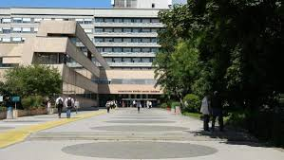
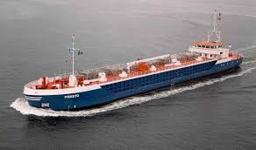
UMC Ljubljana
N of hospital beds | 2.160
N od hospital admissions | 117.088
N of ambulatory visits | 771.242
Length of stay | 5,6 days
Employed in 2016 | 8.062
Health-care workers
Doctors (medical and dental) | 1.266
Nurses | 3.937
Others | 2.859
https://www.kclj.si/index.php?dir=/ukc_ljubljana/o_nas/osebna_izkaznica_ukcl

Slide 3
Structure: Organisation of antimicrobial stewardship in UMC Ljubljana
Medical director, Medical Council
Antibiotic Committee
Department
Department
Department
Department of Infectious Diseases, The consultancy unit
Department
Department
Department
Department
Pharmacy
Microbiology Laboratory (outside)

Slide 4
The use of antibacterial (J01) 1998 to 2017 in DDD/100 patient-days

Slide 5
The use of antibacterial (J01) 1998 to 2017 in DDD/100 admissions

Slide 6
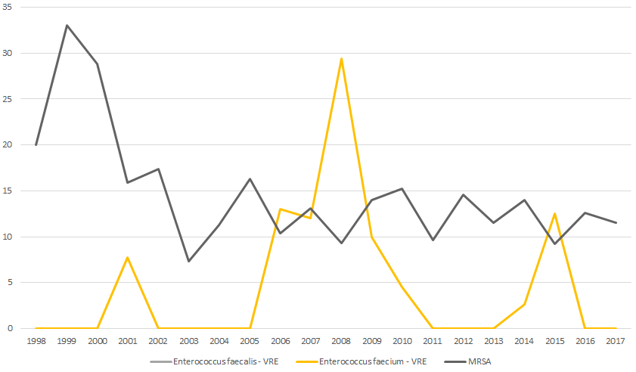
Resistance rates of bacteria isolated from sterile specimens 1998 – 2017: Gram-positive isolates
Beović B, et al. Infektološki simpozij 2018

Slide 7
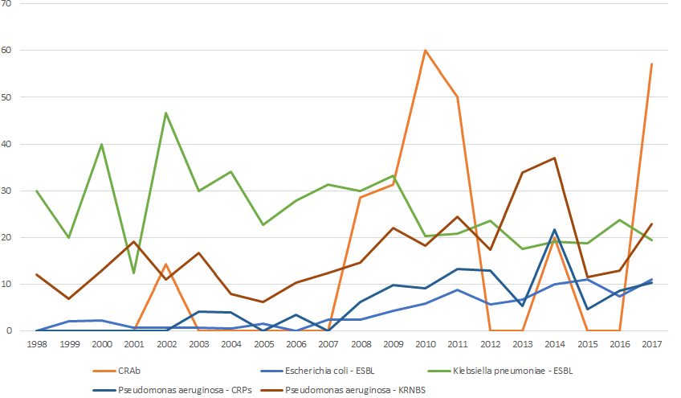
Resistance rates of bacteria isolated from sterile specimens 1998 – 2017: Gram-negative isolates
Beović B, et al. Infektološki simpozij 2018

Slide 8
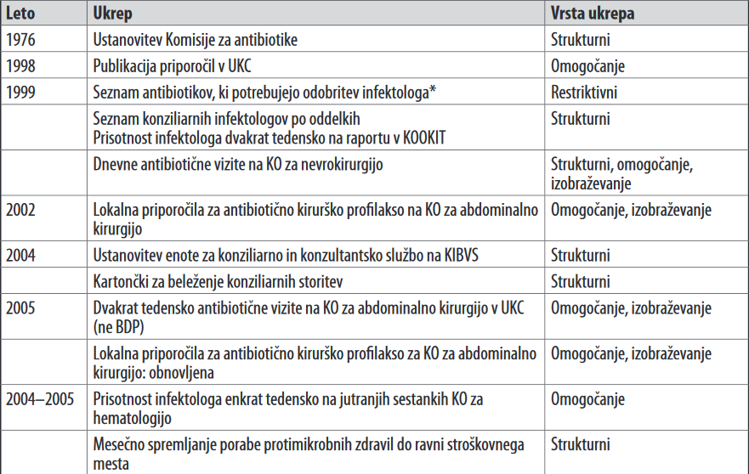
UMC Ljubljana

Slide 9
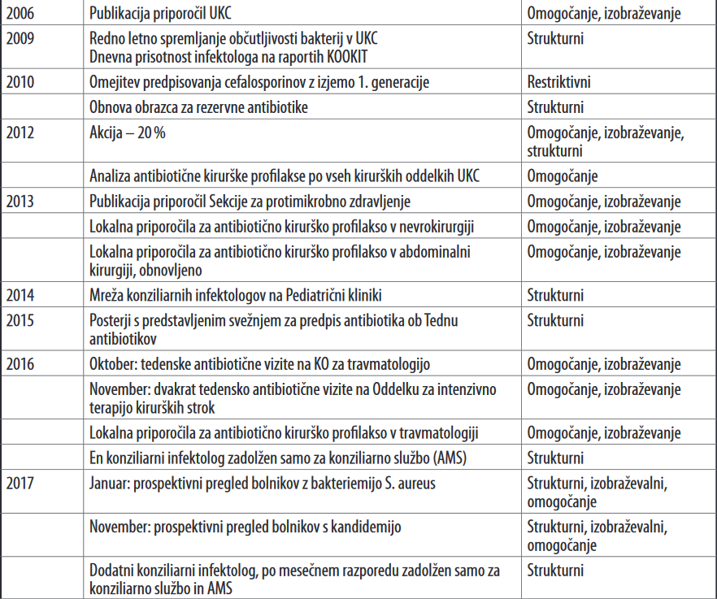

Slide 10
UMC Ljubljana: restrictive interventions

Slide 11
List of restricted antimicrobials
1999
Criteria
last line antibiotics
toxicity
cost
Procedure
approval by an ID physician needed
form for the approval
ICUs: approval by the head of the unit or ID
hematology: approval by the head of the unit

Slide 12
Restrictive interventions: antibiotics
1998 | 2008 | 2010 | + New antibiotics put on the list after their approval for the use in UMC Ljubljana
ceftazidim | ceftazidim | ceftazidim | tedizolid
ceforepazon |  |  | ceftolozan/tazobaktam
cefpirom |  |  | ceftazidim/avibaktam
imipenem | imipenem | imipenem | ceftarolin
meropenem | meropenem | meropenem | dalbavancin
aztreonam |  |  | daptomicin
vankomicin | vankomicin | vankomicin
teikoplanin | teikoplanin | teikoplanin
amikacin | amikacin | amikacin
tobramicin | tobramicin | tobramicin
kloramfenikol | kloramfenikol | kloramfenikol
 | linezolid | linezolid
 | cefepim | cefepim
 | pipracilin/tazobaktam | Piperacilin/tazobaktam
 |  | cefotaksim
 |  | cetriakson
 |  | ceftibuten
 |  | cefiksim
 |  | cefuroksim
 |  | cefuroksim aksetil
 |  | ciprofloxacin i.v.
 |  | tigecycline

Slide 13

Do restrictions work?

Slide 14
Use of antibiotics (J01) 1998 to 2017 (DDD/100 patient-days)
UKC: total use, R: restricted antimicrobials

Slide 15
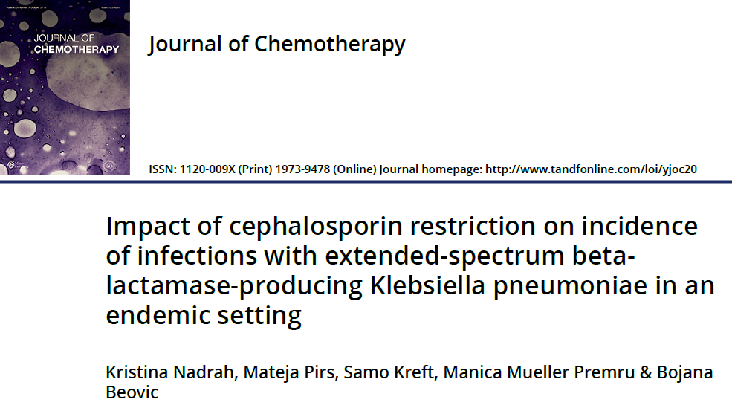
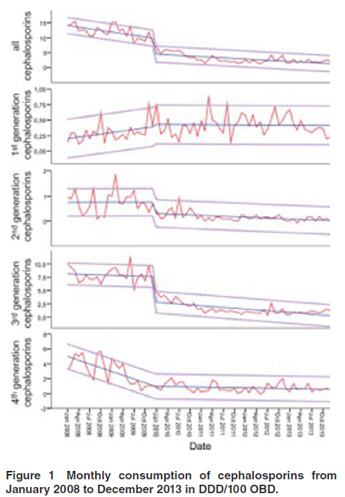
2010
Restriction of 2nd, 3rd, and 4th generation cephalosporins
1st generation could be used for surgical prophylaxis
The decrease of use of all cephalosporins, 2nd and 3rd generation was statistically significant.

Slide 16
Resistance rates of bacteria isolated from sterile specimens 1998 – 2017: Gram-negative isolates
Beović B, et al. Infektološki simpozij 2018

Slide 17
Which Intervention to Choose?
Preprescription Authorisation: the prescriber seeks input from an expert (AMS team) before prescribing an antibiotic.
vs
Prospective audit (postprescriptional review) and feedback: prescriber decides on antimicrobial therapy himself, the AMS team intervenes after 48 to 72 hours: adjustment, discontinuation…
A recent comparison in a crossover study showed:
Improved adherence to guidelines in prospective audit/feedback on day 3
Lower antibiotic use in prospective audit/feedback
Tamma PD, et al. Clin Infect Dis 2017;64(5):537–43

Slide 18
„Campaigns“

Slide 19
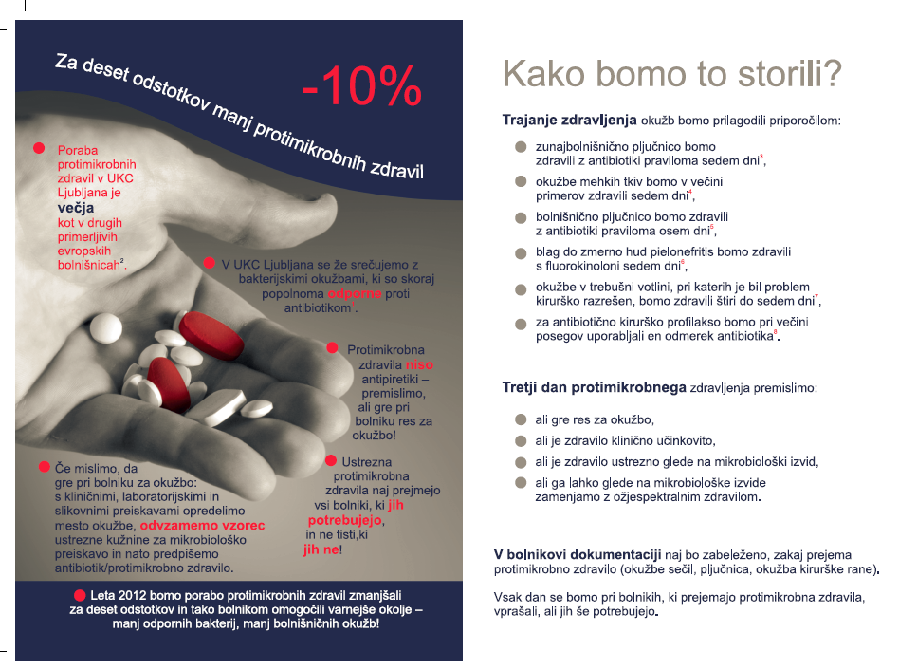
Duration of antimicrobial treatment

Slide 20
Use of antibiotics (J01) 1998 to 2017 (DDD/100 patient-days)
UKC: total use, R: restricted antimicrobials

Slide 21
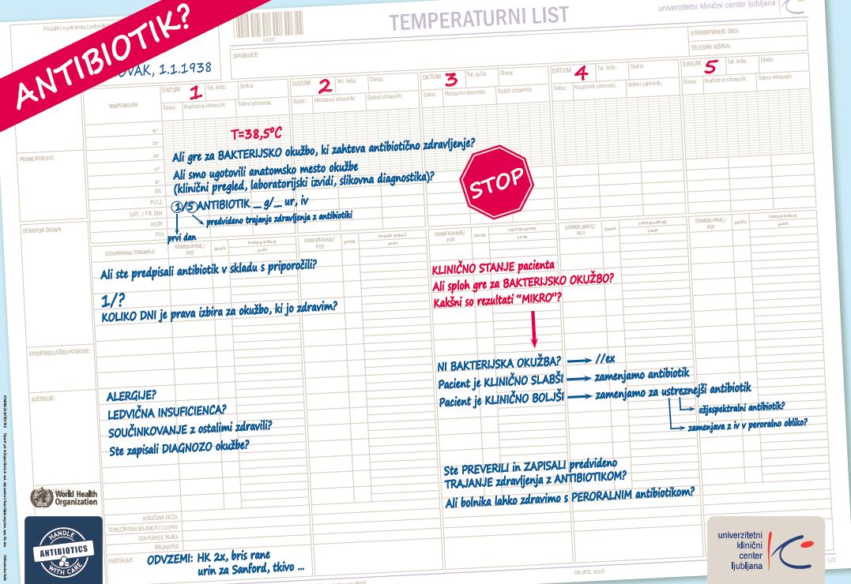

Slide 22
„Antibiotic rounds“

Slide 23
Total control of antibiotic use: Relative Change in Antimicrobial Consumption A: restricted antimicrobial approved by ID B: restricted antimicrobials approved by the head of the unit C:: total control of antibiotic use by ID
NS
NS
P=0.006
Beović B, et al. J Chemother 2009.
Notes:
Na širini črtice med 1998 in 1999 (na zečetku leta 1999) narišite na graf puščico, ki označuje začetek intervencije
Ali se lahko vsaka črta pojavi zase ali še bolje vse črte iz leta v leto skupaj in nato textboxi?

Slide 24
Relative Change in Antimicrobial Cost (Eur)
NS
p=0.016
153 941 Eur
p=0.026
94 537 Eur
Beović B, et al. J Chemother 2009.
Notes:
Enako kot prejšnji dia
Textboxi z denarjem naj izhajajo iz 1. Rumenega in iz zadnjega rumenega trikotnika, po možnosti naj se to pojavi čisto na koncu

Slide 25
Monthly cost of antibiotics at the Division of Traumatology (Eur)
Antibiotic rounds
Monthly mean 2012-2015
Monthly mean Oct 2016 to May 2018

Slide 26
UMC Ljubljana: the guidelines

Slide 27

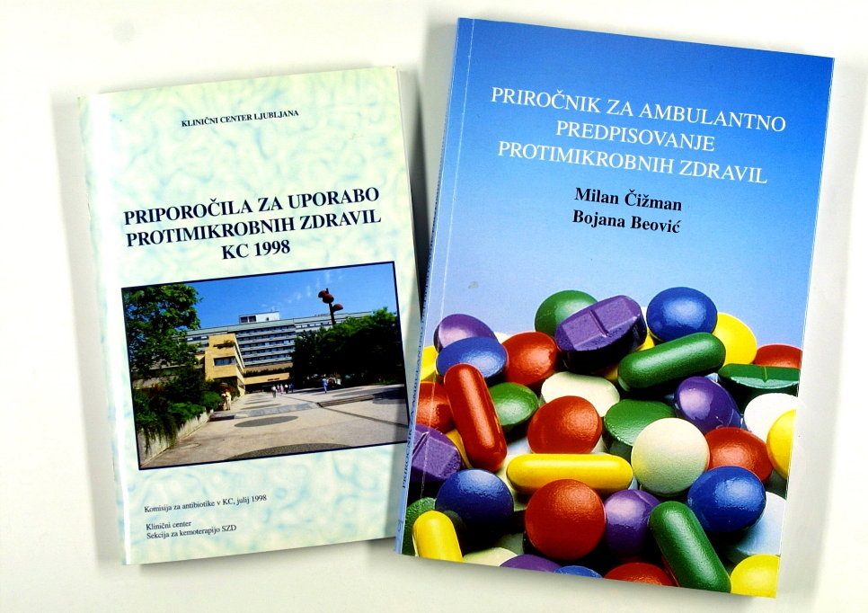

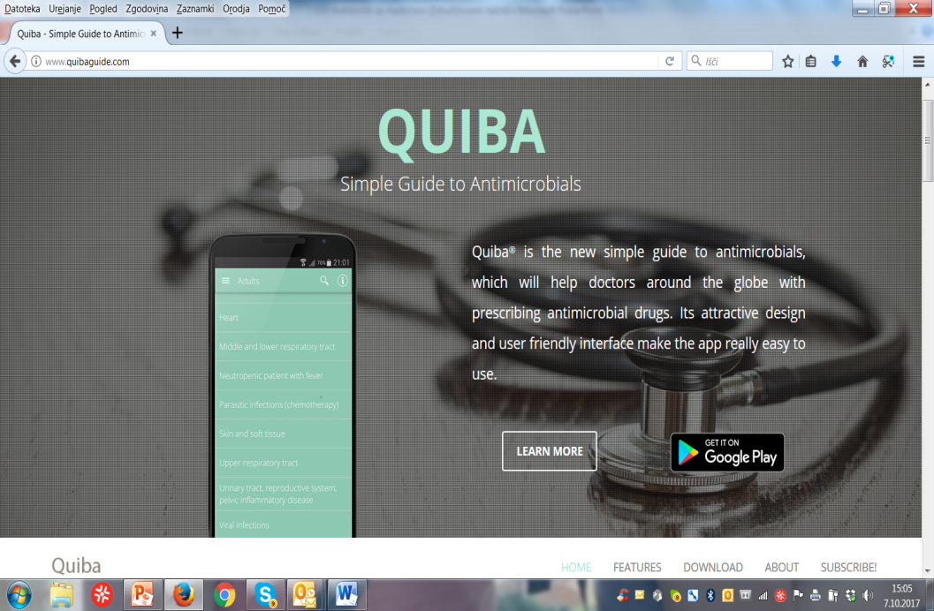

Guidelines: local and national
www.quibaguide.com

Slide 28
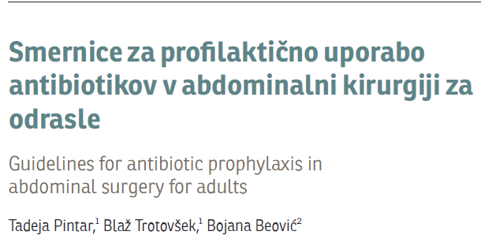
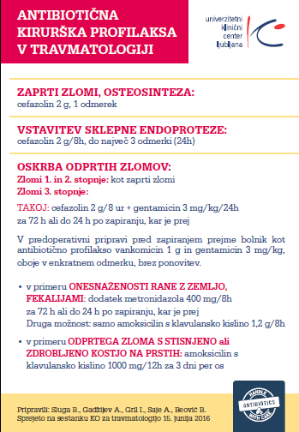

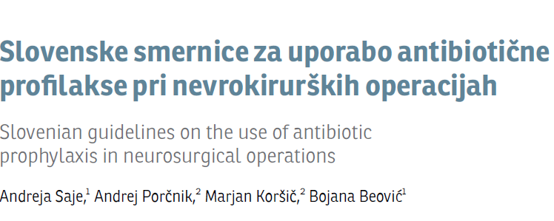

Antimicrobial prophylaxis in surgery

Slide 29
Duration of antimicrobial prophylaxis in UMC Ljubljana
Rožič M, et al. Infektološki simpozij 2016, ECDC PPS 2017, unpublished

Slide 30


Slide 31
Recommended Staffing for AMS Programmes in Hospitals
Country
Australia | Minimum: 4 FTE per 1000 acute-care beds (0.1 FTE of a lead physician and 0.3 FTE of a senior pharmacist/100 beds)
Austria and Germany | Minimum: 2 FTE per 1000 acute-care beds
Canada | Minimum: 4.9 FTE per 1000 acute-care beds (Physician: 1 FTE, pharmacists 3 FTE + coordinator 0.5 FT + data manager 0.4 FTE per 1000 beds)
France | Optimal: 3.6 FTE ID specialist + 2.5 FTE pharmacist + 0.6 FTE microbiologist per 1000 acute-care beds (=6.7 FTE)
The Netherlands | Initiation phase: Optimal standard Hospital <300 beds: 100 hours one time + 0.87 FTE per year Hospital 300-750 beds: 100 hours one time + 1.2 FTE per year Hospital >750 beds: 100 hours one time + 1.53 FTE per year Consolidation phase: Minimum standards Hospital <300 beds: 1.25 FTE per year Hospital 300-750 beds: 2.14 FTE per year Hospital >750 beds: 3.0 FTE per year
Pulcini C, et al. Clin Microbiol Infect 2017;23:785e787

Slide 32
AMS in UMC Ljubljana: the way forward

Slide 33
Antimicrobial use strategy in UMC Ljubljana 2019-24
1 FTE per 500 hospital beds, inclusion of clinical pharmacist
Prospective audit and feed-back in some departments (ICU)
Introduction of antibiotic rounds in more departments
Local guidelines for common syndromes (simple, clear messages)
Antibiotic surgical guidelines
Therapeutic drug monitoring (informatisation)
Computerised prescribing of antibiotics
Guidelines for rapid microbiology diagnostics
Mandatory on-line courses in antimicrobial prescribing for young doctors in training
Approved by Medical Council UMC Ljubljana, October 2018

Slide 34

Thank you!

