Slide 1


Što je to upravljanje antimikrobnim lijekovima i kojim metodama se može provesti?
Prof Bojana Beović
UMC Ljubljana
Faculty of Medicine, University of Ljubljana
Slovenia

Slide 2
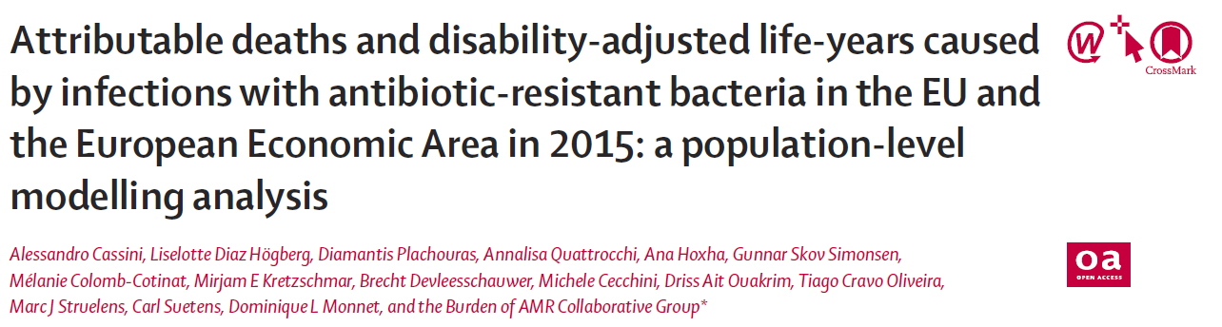
33 110 (28 480–38 430) attributable deaths
(25,100 in 2007 = + 32%!!!)
170 (150–192) DALYs* per 100 000 population
*DALY, disability-adjusted life-years
Lancet ID 2018. Published Online November 5, 2018 http://dx.doi.org/10.1016/S1473-3099(18)30605-4
ECDC, EMEA. EMEA doc. ref. EMEA/576176/2009, Stockholm, September 2009

Slide 3
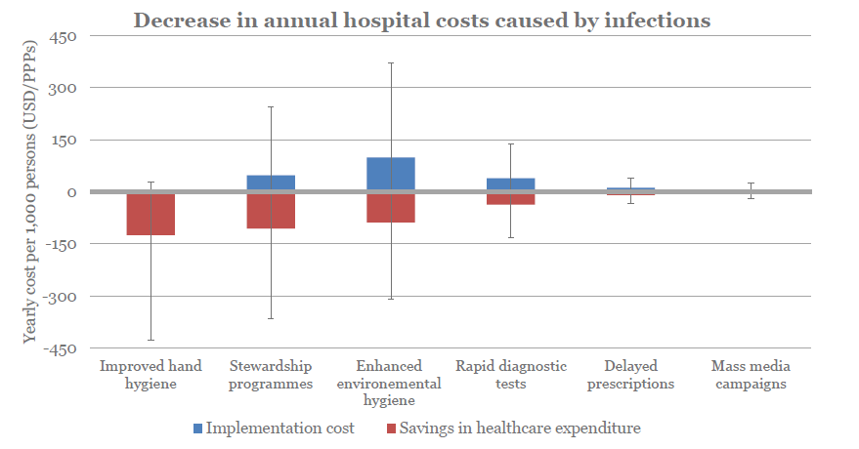

Cost – effectiveness od interventions to control antimicrobial resistance
Presented at the WAAD Meeting organized by WHO, IPH, and MoH in Ljubljana, 15 November 2018.

Slide 4
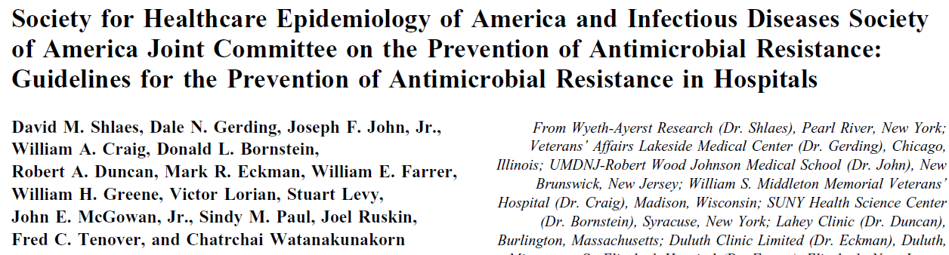
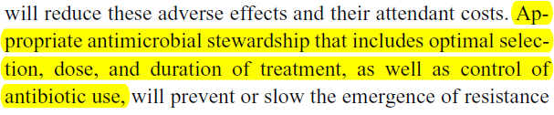
IDSA/SHEA: 1997
Shlaes D, et al. Clin Infect Dis. 1997;25:584–99

Slide 5
Definitions of AMS: 2012–2018
ESGAP:¹ A set of actions or a programme aimed at ensuring responsible antibiotic use.
IDSA/SHEA:² Coordinated interventions designed to improve and measure the appropriate use of antimicrobials by promoting the selection of the optimal antimicrobial drug regimen, dose, duration of therapy, and route of administration.
WHO:³ Interventions designed to optimise use of antibiotics.
1. Dyar OJ, et al. Clin Microbiol Infect. 2017;23(11):793–98;
2. Fischer N, et al. Infect Control Hosp Epidemiol. 2012;33(4):322–27;
3. Van Dijck C, et al. Bull World Health Organ. 2018;96:266–80

Slide 6
Why do we need AMS?
A few simple facts:
Antibiotics cause antimicrobial resistance^{1,2}
Antibiotic resistance decreases efficacy of antibiotics¹
There are very few new antibiotics that are effective against resistant bacteria^{1,2}
Antibiotics can prescribed by virtually all practising physicians, regardless of speciality¹
Education on antibiotic resistance^{1,2} and prescribing² is deficient
1.Global Action Plan on Antimicrobial Resistance. World Health Organization 2015 http://www.who.int/antimicrobial-resistance/publications/global-action-plan/en/ [Last accessed September 2018]., 2. Pulcini C, Gyssens IC. Virulence; 2013:4(2):192–202

Slide 7


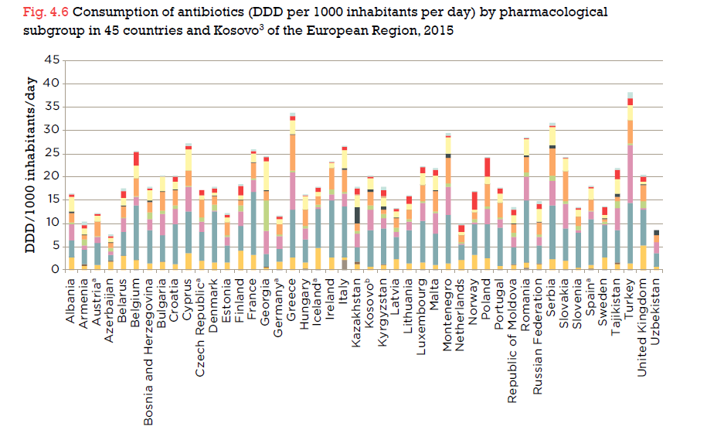

Slide 9
Key factors contributing to antimicrobial misuse
Diagnostic uncertainty
Is there a bacterial infection in this wound?
Clinician ignorance
When to treat with antibiotics
Clinician fear
Of failing to treat properly, or of having a bad outcome
Patient demands
For unnecessary antibiotic therapy
Lipsky B, et al. J Antimicrob Chemother. 2016;71(11):3026–35.

Slide 10
AMS Interventions in Hospitals Are They Effective?

Slide 11
AMS Studies
Can we learn anything from the studies:
Differences in antimicrobial resistance
Differences in healthcare systems
Different group of patients
Other interventions that target the same goal (IC)
Different sociocultural environment
….

Slide 12
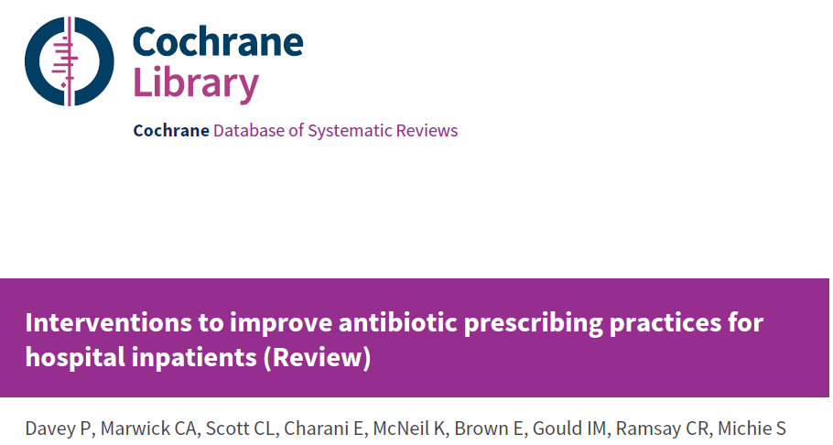
The Efficacy of AMS Interventions in Hospitals
The Review includes studies from 1947 to 2015
Better compliance to antibiotic prescribing policy (high certainty evidence)
The duration of antibiotic treatment decreased by 1.95 days (high certainty evidence)
Reduced length of stay by 1.12 days (moderate certainty evidence)
reduced Clostridium difficile infections (low certainty evidence)
It was not possible to assess the microbial outcome of changed antimicrobial policy
Risks
Mortality remained unchanged (moderate certainty evidence)
Delayed treatment and negative professional culture (low certainty evidence)
Davey P, et al. Cochrane Database Syst Rev 2017, Issue 2. Art. No.: CD003543.

Slide 13
The Efficacy of AMS Interventions by Type
Enablement and restriction increase the compliance with AMS policies.
Enablement increases the effect of restriction.
Enablement with feed-back is probably more effective than enablement alone.
Davey P, et al. Cochrane Database Syst Rev 2017, Issue 2. Art. No.: CD003543.

Slide 14
AMS Interventions Which Intervention?

Slide 15
Do the AS Objectives Have an Impact on AS Goals? (Which Objectives Really Matter?)
empirical therapy according to guidelines
de-escalation of therapy
switching from intravenous to oral treatment
therapeutic drug monitoring
use of a list of restricted antibiotics
bedside consultations
Clinical outcomes
Adverse events
Costs
Resistance rates
Current evidence on hospital AMS objectives

Slide 16
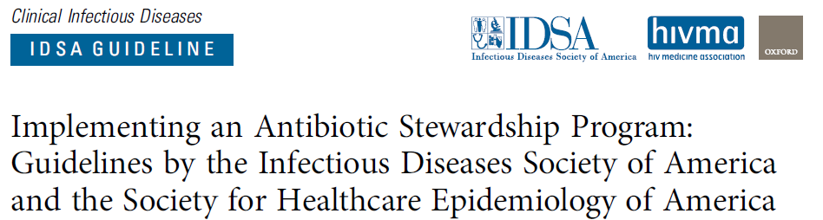
Strong recommendations (all moderate level of evidence)
Preauthorisation/prospective audit and feeback
Reduced use of antibiotics associated with Clostridium difficile infections
Increased use of oral antibiotics
Shortest effective duration of antimicrobial therapy
PK optimization of aminoglycoside therapy
Barlam TF, et al. Clin Infect Dis 2016;62(10):e51–e77

Slide 17
Preprescriptional Restrictions or Prospective Audit and Feed-back

Slide 18
Preprescription Authorisation: the prescriber seeks input from an expert (AMS team) before prescribing an antibiotic.
Advantages
Reduces initiation of unnecessary/ inappropriate antibiotics
Optimizes empiric choices and influences downstream use
Prompts review of clinical data/prior cultures at the time of initiation of therapy
Decreases antibiotic costs, including those due to high-cost agents
Provides mechanism for rapid response to antibiotic shortages
Direct control over antibiotic use
Disadvantages
Impacts use of restricted agents only
Addresses empiric use to a much greater degree than downstream use
Loss of prescriber autonomy
May delay therapy
Effectiveness depends on skill of approver
Real-time resource intensive
Potential for manipulation of system (eg, presenting request in a biased manner to gain approval)
May simply shift to other antibiotic agents and select for different antibiotic-resistance patterns
Tamma PD, et al. Clin Infect Dis 2017;64(5):537–43.

Slide 19
Prospective audit (postprescriptional review) and feedback: prescriber decides on antimicrobial therapy himself, the AMS team intervenes afer 48 to 72 hours: adjustment, discontinuation…
Advantages
Can increase visibility of antimicrobial stewardship program and build collegial relationships
More clinical data available for recommendations, enhancing uptake by prescribers
Greater flexibility in timing of recommendations
Can be done on less than daily basis if resources are limited
Provides educational benefit to clinicians
Prescriber autonomy maintained
Can address de-escalation of antibiotics and duration of therapy
Disadvantages
Compliance voluntary
Typically labor-intensive
Success depends on delivery method of feedback to prescribers
Prescribers may be reluctant to change therapy if patient is doing well
Identification of interventions may require information technology support and/or purchase of computerized surveillance systems
May take longer to achieve reductions in targeted antibiotic use
Tamma PD, et al. Clin Infect Dis 2017;64(5):537–43.

Slide 20
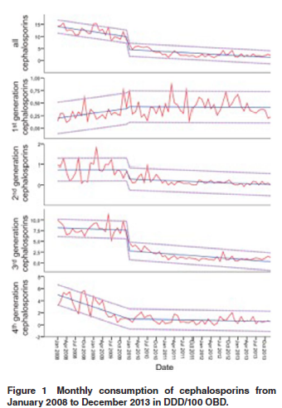
Which Intervention to Choose?
Effective restriction of cephalosporins (1st generation excluded) with
preprescriptional authorisation
A recent comparison in a crossover study showed:
Improved adherence to guidelines in prospective audit/feedback on day 3
Lower antibiotic use in prospective audit/feedback
Tamma PD, et al. Clin Infect Dis 2017;64(5):537–43
Nadrah K, et al. J Chemother 2018; DOI: 10.1080/1120009X.2018.1434917

Slide 21
De-escalation

Slide 22

The Theoretical Concept of De-escalation
Timely broad-spectrum antibiotic treatment
Narrower spectrum adapted to the isolate and its susceptibility
pathogen isolation
(exclusion of a pathogen)
Successful control of infection (morbidity, mortality)
Limited antibiotic selection pressure
(Lower antibiotic cost)
Societal benefit: safeguarding the activity of empirical treatment
Individual patient benefit

Slide 23
De-escalation: current state of evidence
Very few data and unconvincing effect on antimicrobial resistance.
No effect on Clostridium difficile infections.
Lower mortality in observational studies and controversial results of randomized controlled trials.
Paul M, et al. Clin Microbiol Infect 2016;22:960e967., Ohji G, et al. Int J Infect Dis 2016;49:71–9., Guo Y, et al. Heart Lung 2016;45:454e459. Gutiérrez-Pizarraya A, et al. Expert Rev Clin Pharmacol 2017. DOI: 10.1080/17512433.2017.1293520., Tabah A, et al. Clin Infect Dis 2016;62:1009–17., Snyder M, et al. OFID 2017. DOI: 10.1093/ofid/ofx226., Viasus D, et al. J Antimicrob Chemother 2017;72:547–53., Leon M, et al. Intensive Care Med 2014;40:1399–408., Bohan JG, et al. OFID 2016. doi: 10.1093/ofid/ofw244., Rattanaumpawan P, et al. BMC Infect Dis 2017;17:183., Falguera M, et al. Thorax 2010;65:101e106., Xiao B, et al. Exper Ther Med 2017;13:1485-89., Kim JW, et al. Critical Care 2012, 16:R28.

Slide 24
Controversies! Practical Tips for Safe (and Effective) De-escalation
Consider de-escalation when there is high impact of empirical treatment and high need to preserve its efficacy.
Consider de-escalation when second antibiotic therapy with lower resistance selection potential with respect to the setting is available.
Make proper clinical diagnosis of infection.
Assure relevant microbiological diagnostics.
Use rapid diagnostics to accelerate the de-escalation and shorten the exposure to first antibiotic.
Second antibiotic therapy should be given in a dose that attains the PK/PD target and the therapeutic concentration in the tissue.
If possible: discontinuation of an antibiotic is more effective than de-escalation.
Giantsou E, et al. Intensive Care Med 2007; 33:1533–40., Tabah A, et al. Clin Infect Dis 2016;62:1009–17., Paul M, et al. Clin Microbiol Infect 2016;22:960e967, Xiao B, et al. Exper Ther Med 2017;13:1485-89, Carlier M, et al. Antimicrob Agents Chemother 59:4689 –94

Slide 25

Duration of Antimicrobial Treatment

Slide 26
The Differences between the Shortest Recommended (SR) and Recommended (R) Duration in the ESCMID Survey
Syndrome | R | SR
Patient with acute cholangitis, successfully and rapidly treated by endoscopic biliary drainage | 7 | 5
Patient with diffuse peritonitis (after surgery with an early adequate source control) | 7 | 5
Outpatient with an uncomplicated pneumonia | 7 | 5
Patient presenting an acute exacerbation of a severe COPD | 7 | 5
Patient presenting an uncomplicated catheter-related Staphylococcus aureus bacteraemia (without endocarditis and with early removal of the catheter), after negative blood cultures | 14 | 10
Patient presenting a diabetic foot infection, with bone infection, not eligible for surgery | 42 | 28
An adult with an uncomplicated bacterial maxillary sinusitis | 7 | 5
Macheda G et al, J Antimicrob Chemother 2018; 73: 1084–90.

Slide 27

The Team

Slide 28
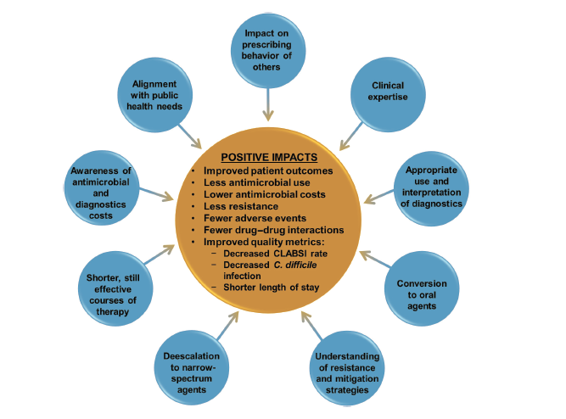
Skills of an ID Physician as the Antimicrobial Stewardship Programme Leader
Ostrowsky B, et al. Clin Infect Dis 2018; 66:995-1003.

Slide 29


Slide 30
Recommended Staffing for AMS Programmes in Hospitals
Country
Australia | Minimum: 4 FTE per 1000 acute-care beds (0.1 FTE of a lead physician and 0.3 FTE of a senior pharmacist/100 beds)
Austria and Germany | Minimum: 2 FTE per 1000 acute-care beds
Canada | Minimum: 4.9 FTE per 1000 acute-care beds (Physician: 1 FTE, pharmacists 3 FTE + coordinator 0.5 FT + data manager 0.4 FTE per 1000 beds)
France | Optimal: 3.6 FTE ID specialist + 2.5 FTE pharmacist + 0.6 FTE microbiologist per 1000 acute-care beds (=6.7 FTE)
The Netherlands | Initiation phase: Optimal standard Hospital <300 beds: 100 hours one time + 0.87 FTE per year Hospital 300-750 beds: 100 hours one time + 1.2 FTE per year Hospital >750 beds: 100 hours one time + 1.53 FTE per year Consolidation phase: Minimum standards Hospital <300 beds: 1.25 FTE per year Hospital 300-750 beds: 2.14 FTE per year Hospital >750 beds: 3.0 FTE per year
Pulcini C, et al. Clin Microbiol Infect 2017;23:785e787

Slide 31
Education

Slide 32
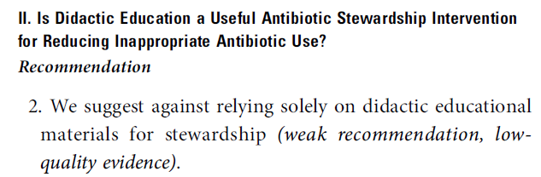


IDSA & SHEA Guidelines for Implementation of Antimicrobial Stewardship in Hospitals
2007
2016
Education is essential!
(strong recommendation, low level of evidence)
Dellit TH, et al. Clin Infect Dis 2007; 44:159–77. , Barlam TF, et al. Clin Infect Dis 2016;62(10):e51–e77

Slide 33

What Type of Education in AMS is Most Successful?
Systematic review of 28 RTCs
Antibiotic prescription decreased by 9 to 52%
Innapropriate prescriptions decreased by 41% on average
Small group education seems to most effective (52%) followed guidelines and leaflets (42%)
Lee CR, et al. Biomed Res Int 2015; Article ID 214021

Slide 34
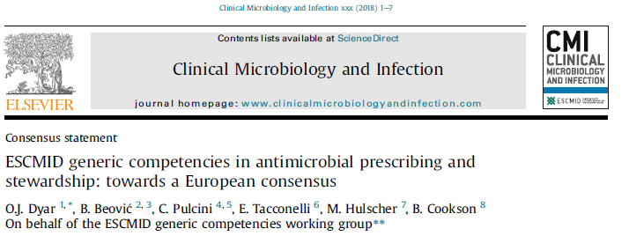
Competencies in antimicrobial prescribing and AMS
Competency is the ability to do something successfully or efficiently. It is a combination of knowledge, skills, motives and personal traits.
ESCMID Generic Competencies in Antimicrobial Prescribing and AMS
What every independent antibiotic prescriber should know and practice.

Slide 35
Barriers and Facilitators of AMS
Scientific (e.g., uncertainty of future medical needs)
Economic (e.g., lack of financial incentives)
Regulatory (e.g., regulatory harmonisation)
Ethical (e.g., responsibility for future generations)
Societal (e.g., ‘invisibility’ of antibacterial resistance)
Political (e.g., changing political environment)
Professional practice challenges (e.g., alternatives to antibiotics)
Monnier A, et al. Poster P1713, presented at ECCMID 2018.

Slide 36
Sociocultural aspect Regulatory aspect

Slide 37
Sociocultural dimensions of antibiotic prescribing
Differences in antibiotic use between EU countries can be explained with sociocultural dimensions¹
Differences in outpatient antibiotic use can be explained by power distance, uncertainty avoidance, hierarchy, masculinity and religion²
Differences in antibiotic use for cold, flu and sore throat identified by Eurobarometer are concordant with uncertainty avoidance and masculinity in the society³
Frequency of prolonging antibiotic surgical prophylaxis beyond 24 hours is concordant with uncertainty avoidance⁴
1. Hulscher M, et al. Lancet Infect Dis. 2010;10(3):167–75,
2. Deschepper R, et al. BMC Health Serv Res. 2008;8:123;
3. Borg M. J Antimicrob Chemother. 2012;67(3):763–7;
4. Borg M. J Antimicrob Chemother. 2014;69(4):1142–4.

Slide 38
Legal framework for AMS in Europe (An ESCMID/ESGAP survey) 25 countries and two Italian regions
Beovic/p5/line 43-51
No regulations/strategy/action plan adopted by ministry of health in 5 countries!
AMS, antimicrobial stewardship
Beović B, et al. Int J Antimicrob Agents. 2018. [Epub ahead of print].

Slide 39
Conclusion
AMS interventions increase the adherence to guidelines in improve the quality of antimicrobial prescribing.
The multidisciplinary team, preferably led by infectious diseases specialist, should have the authority and should be compensated for the time dedicated to AMS.
Carefully chosen interventions should take into account sociocultural characteristics of the setting.

