Slide 1

What are the effects of antimicrobial stewardship programmes – cost-reduction and much more?
Croatian Society for Infectious Diseases
of the Croatian Medical Association
Marija Santini
University Hospital for Infectious Diseases
“Dr Fran Mihaljevic”
Zagreb
Zagreb, 7.12.2018.

Slide 2
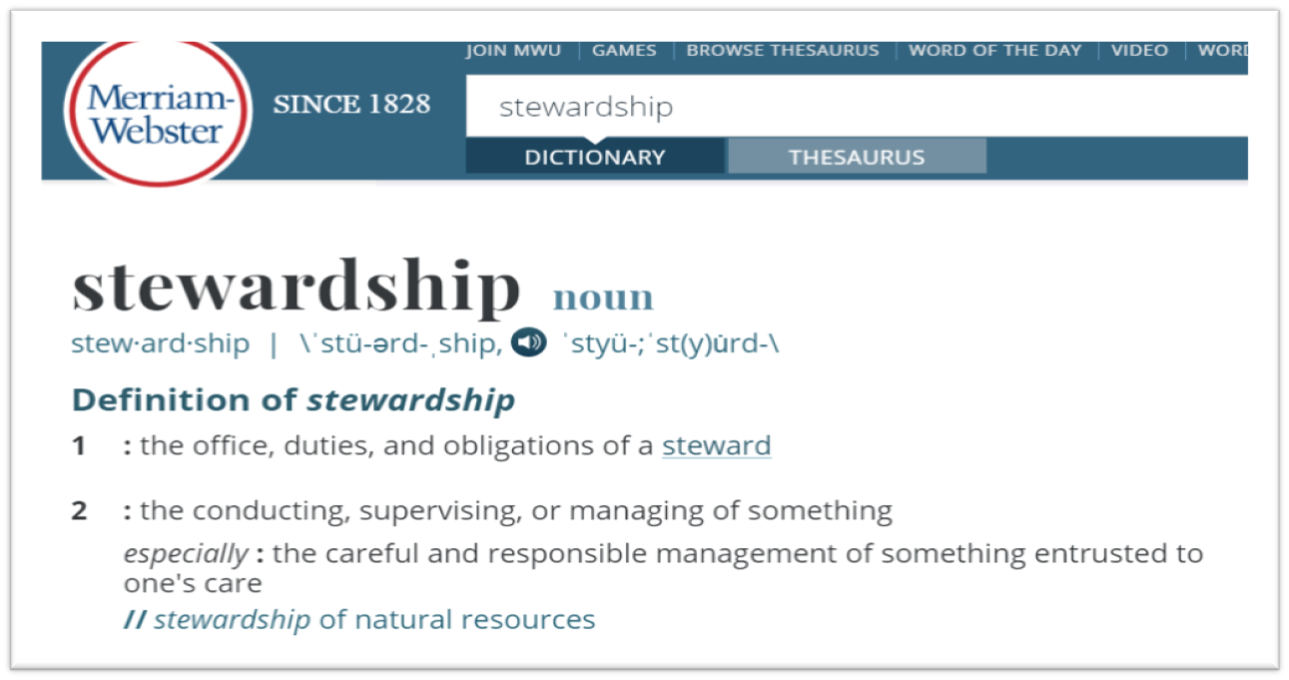
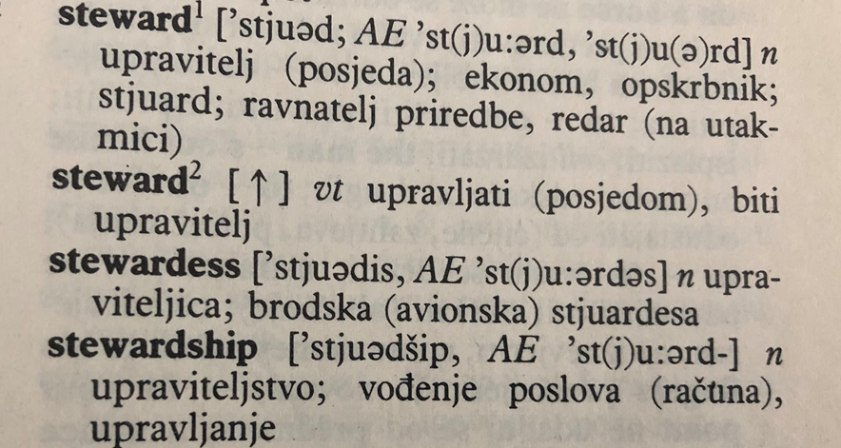
Antimicrobial stewardship (AMS) programme - what is an adequate Croatian term?
Upravljanje, rukovođenje, nadzor, vođenje, kontrola, poboljšanje primjene…

Slide 3
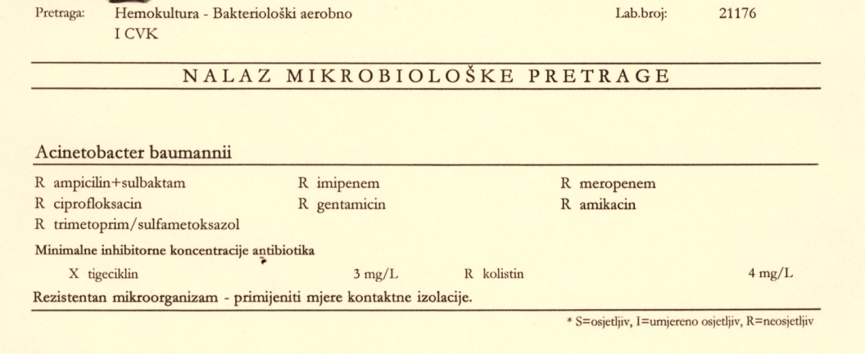
Antimicrobial stewardship programme – why?
Acinetobacter baumannii – ↑carbapenem resistant >80%
Klebsiella pneumoniae – ↑ ESBL 30%, carbapenemase producing…
Pseudomonas aeruginosa – carbapenem resistant 15-30%
Enterococcus faecium – ↑VRE 18%
Staphylococcus aureus – ↑ MRSA 16%
Annual Reports of the Committee for Antibiotic Resistance Surveillance in Croatia, Croatian Academy of Medical Sciences, 31 – 40 centers (90% of population)

Slide 4
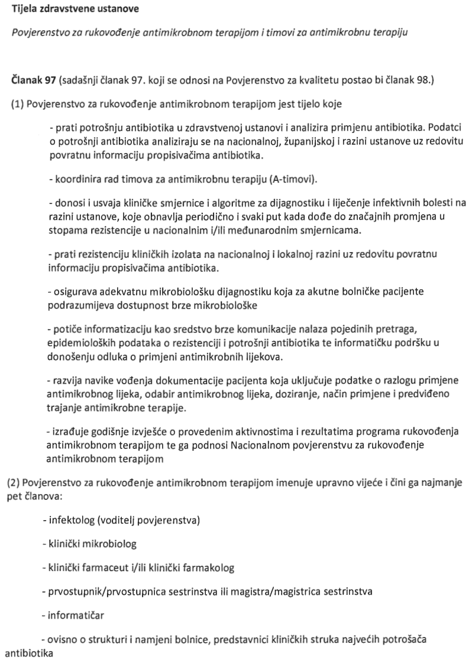
Antimicrobial stewardship programme…
May, 2018
Croatian Society for Infectious Diseases an official
attempt to introduce the AMS into the Health Care Act, coming into force on 1 January 2019

Slide 5
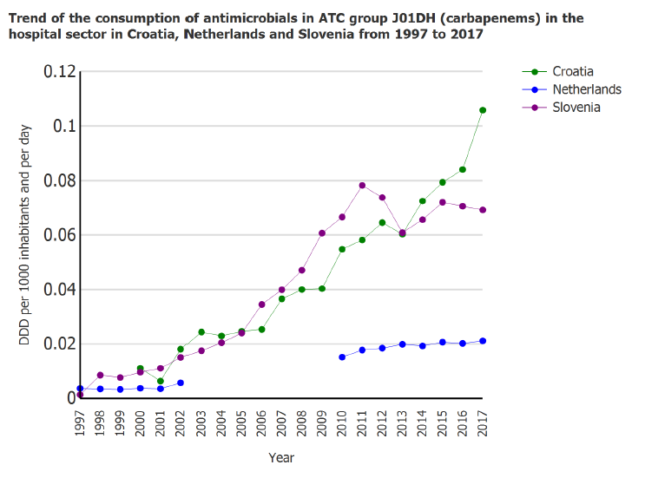

Does Croatia need AMS programmes?
Hospital consumption of antibiotics
ATC J01DH – carbapenems
Courtesy of Prim. Marina Payer-Pal, Institute for Public Health of Međimurje County, Croatia
Simpozij povodom obilježavanja Europskog dana svjesnosti o antibioticima i Svjetskog tjedna svjesnosti o antibioticima
Zagreb, 16.studenoga 2018.

Slide 6
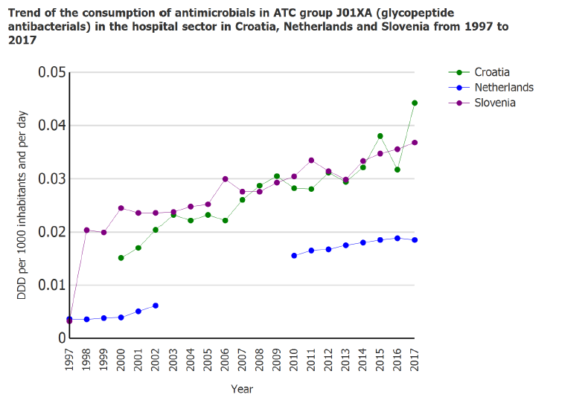
Does Croatia need AMS programmes?
Hospital consumption of antibiotics
ATC J01XA – vancomycin
Simpozij povodom obilježavanja Europskog dana svjesnosti o antibioticima i Svjetskog tjedna svjesnosti o antibioticima
Zagreb, 16.studenoga 2018.
Courtesy of Prim. Marina Payer-Pal, Institute for Public Health of Međimurje County, Croatia

Slide 7
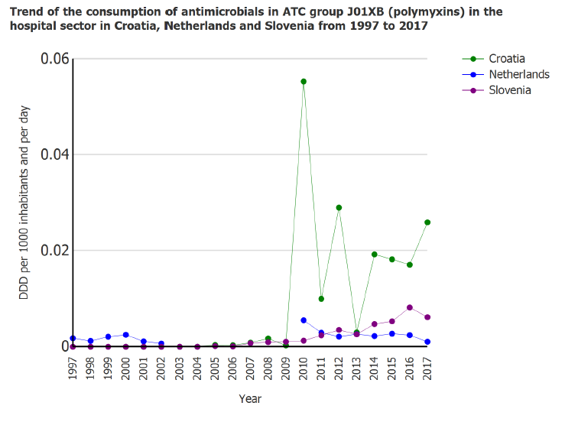
Does Croatia need AMS programmes?
Hospital consumption of antibiotics
ATC J01XB – colistin
Simpozij povodom obilježavanja Europskog dana svjesnosti o antibioticima i Svjetskog tjedna svjesnosti o antibioticima
Zagreb, 16.studenoga 2018.
Courtesy of Prim. Marina Payer-Pal, Institute for Public Health of Međimurje County, Croatia

Slide 8
Some forgotten facts about antibiotics and some questions
Antibiotics are still powerful
The only medication that can stop lethal illness
The only medication that has an effect on the individual and on the community
Are we dealing with antibiotics carefully enough?
Should antibiotics be a general good?

Slide 9
Hospital Quality Indicators (QI)
measure quality of the health services provided
allow mutual hospital comparison in:
quality of health care provided
progress in achieving better quality of health care
Broj rehospitalizacija unutar 30 dana od otpusta bez obzira na dijagnozu
Opća stopa smrtnosti
Stopa smrtnosti zbog akutnog infarkta miokarda
Stopa smrtnosti zbog moždanog inzulta
Postotak liječenja u dnevnoj bolnici
Postotak prijema kroz hitni prijem
Prosječna duljina boravka u bolnici zbog akutnog pankreatitisa – MKB-10: K85.-
Prosječna duljina boravka u bolnici zbog akutnog infarkta miokarda- MKB-10: I21.-
Prosječna duljina boravka u bolnici zbog inzulta - MKB-10: I63
Prosječna duljina boravka zbog carskog reza
Prosječna duljina boravka u bolnici zbog hernioplastike ingvinalne hernije- MKB-10: K40.9
Postotak pacijenata liječenih rezervnim antibiotikom - % od patients treated by the reserve group antibiotics
Postotak prijema zbog astme
Postotak prijema zbog kronične opstruktivne plućne bolesti (KOPB)
Postotak prijema zbog dijabetesa
Postotak prijema zbog hipertenzije
Postotak slučajeva jednodnevne kirurgije zbog hernioplastike ingvinalne hernije
Postotak slučajeva jednodnevne kirurgije zbog operacije katarakte
Postotak slučajeva jednodnevne kirurgije zbog operacije adenoidektomija/tonzilektomija
Postotak slučajeva jednodnevne kirurgije zbog transuretralne resekcije prostate (TURP)
Postotak slučajeva jednodnevne kirurgije zbog laparoskopske kolecistektomije

Slide 10
Courtesy of Dr. Blaša Bilić, General Hospital Šibenik, Croatia

Slide 11
What are the effects of antimicrobial stewardship programmes?
Patient, physician and societal perspective
Authorities – decision-makers perspective
Decreased numbers of prescriptions for nonbacterial infections
Proper management of known infections ('bug–drug' mismatches)
Less adverse events
Lower C. difficile incidence
Better guidelines adherence
Shorter use of antibiotics
Shorter hospitalization
↓ resistance rate
Responsibility for off-label antibiotic use
Cost-minimization
Patient safety, good clinical practice & cost-optimization

Slide 12
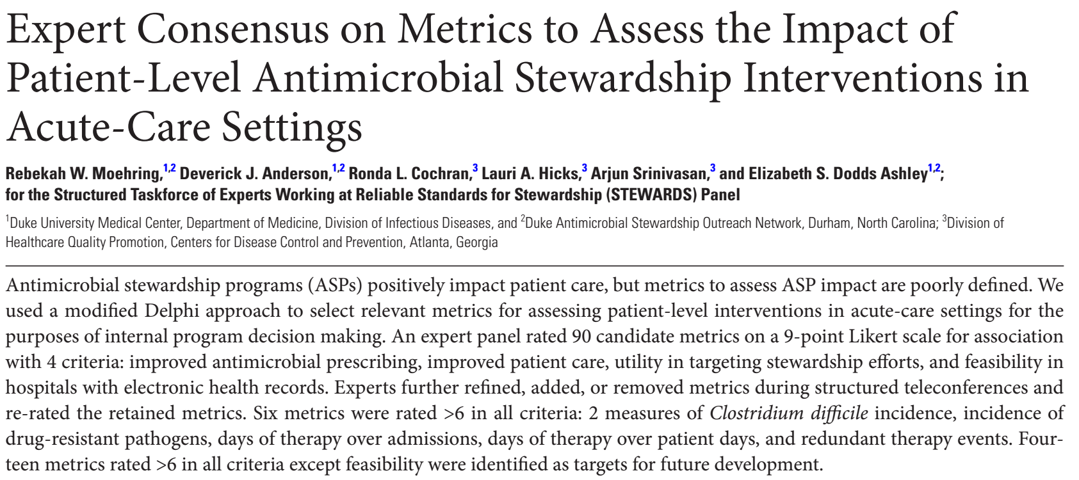

But…
Antimicrobial stewardship programmes are heterogenous
Different methods
Different teams
Different settings (general ward, haematology, ICU, urology, outpatient, chronic care facilities...)
Antimicrobial stewardship programmes depend on HCAI control measures
Outcomes/effects are heterogenous

Slide 13
How to present jointly the costs and effects of different measures?
5
Cost-effectiveness Analysis (CEA)
Change in costs and change in health benefits due to an intervention
Incremental Cost Effectiveness Ratio(ICER)
Δ cost
=
Δ effectiveness
= cost per QALY
Notes:
Koliko košta promjena koju je neka mjera donijela

Slide 14




$$$
7
More
Cost
More costly and less effective
More costly but more effective
Less effective
More Effective
Cost savings less effective
More effective and cost savings
$
Cost savings
Courtesy of Sonali Coulter, PhD, Queensland University of Technology, Brisbane, Australia

Slide 15
Conclusions
Antimicrobial stewardship programmes - measure of patient safety, good clinical practice and cost optimization
The structures of antimicrobial stewardship programmes are diverse and the observed effects are diverse - standardization required (adapted to the state economic possibilities)
Today, the cost-effectiveness analysis is increasingly emphasized

Slide 16
Thanks to…
Vesna Mađarić, ID specialist, General Hospital Koprivnica, Croatia
Marina Payer-Pal, CM, Institute for Public Health of Međimurje County, Croatia
Committee for Antibiotic Resistance Surveillance in Croatia
Intersectoral Coordination Mechanism for the Control of Antimicrobial Resistance (Interdisciplinarna sekcija za kontrolu rezistencije na antibiotike – ISKRA)
Blanša Bilić, ID specialist, General Hospital Šibenik, Croatia
Sonali Coulter, PhD, Queensland University of Technology, Brisbane, Australia
Silvija Šoprek, CM specialist, University Hospital for Infectious Diseases
Arijana Pavelić, professor, head of the library, University Hospital for Infectious Diseases, Zagreb, Croatia
Jasminka Blaha, administrative secretary, Croatian Society for Infectious Diseases

