Slide 1
Antimicrobial stewardship in outpatient settings
Vladimir Krajinović, MD, PhD
Department for Neuroinfections and Intensive Care Unit
University Hospital for Infectious Diseases, Zagreb, Croatia

Slide 2
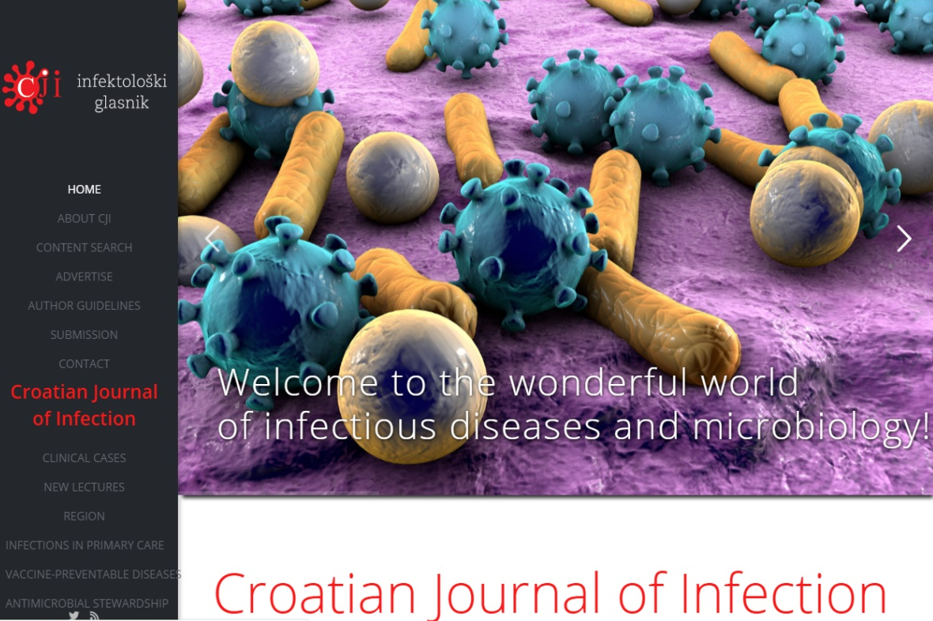
www.cji.com.hr

Slide 3

Antibiotics (ATB)
The discovery of ATB is one of the greatest achievements in medicine
Improvement of outcome in patients:
infections
surgical
cancer
transplant
critical care
Notes:
Otkriće antibiotika jedno je od najvećih dostignuća medicine. Infektolozi trebaju biti sretni što imaju takvu vrstu posla da svakodnevno propisuju takve lijekove.
3

Slide 4

Antibiotic misuse and overuse
Inappropriate antimicrobial use can lead to:
selection of resistant pathogens
Clostridium difficile infections
atb-induced toxicities
adverse drug reactions
High:
morbidity
mortality
health-care costs

Slide 5

ATB resistance
33000 people die every year due to
infections with antibiotic-resistant bacteria
- 330 airplanes
- comparable to that of influenza, tuberculosis and HIV/AIDS combined
- 75% of the burden of disease is due to healthcare-associated infections (HAIs)
- 39% is caused by infections with bacteria resistant to last-line antibiotics such as carbapenems and colistin
Cassini A, et al. Lancet Infect Dis. 2018 Nov

Slide 6
33000 people die every year due to infections with antibiotic-resistant bacteria
Achievable goal in healtcare settings:
adequate infection prevention and control measures, as well as
antibiotic stewardship
It is called "stewardship" because it protects the effectiveness of the most important tool we have to fight life-threatening bacterial infections: antibiotics.

Slide 7
Antimicrobial stewardship (AS)
1997. SHEA and IDSA – guidelines for the prevention of AR, the term antimicrobial stewardship*
2006. CDC – multiple campaigns to target AR
2007. SHEA and IDSA – guidelines for developing AS programs at an institutional level**
2012. SHEA, IDSA, PIDS – expansion of AS to the ambulatory settings, education, and research***
* Shlaes DM, et al. Infect Control Hosp Epidemiol, 1997.
** Dellit TH, et al. Clin Infect Dis, 2007.
*** SHEA, IDSA, PIDS. Infect Control Hosp Epidemiol 2012.
Notes:
SHEA –Society for Healthcare Epidemiology of America
7

Slide 8
Antimicrobial stewardship (AS)
systematic measurement
coordinated interventions
promote the optimal use of antibiotic agents
including their choice
dosing
route
duration of administration
reduce ATB use, improve outcomes, reduce healthcare costs*
*Clin Infect Dis. 2007;44(2):159-177
Clin Infect Dis. 2011;53:(suppl 1)
Notes:
consists of systematic measurement and coordinated interventions designed to promote the optimal use of antibiotic agents, including their choice, dosing, route, and duration of administration
8

Slide 9

Antimicrobial stewardship (AS)
The primary goal of AS:
optimize clinical outcomes while
minimizing unintended consequences*
Additional benefits:
improving susceptibility rates to targeted antibiotics
optimizing resource utilization**
*Infect Control Hosp Epidemiol. 2012;33(4):322.
**Clin Infect Dis. 2016;62(10):e51. Epub 2016 Apr 13.

Slide 10

ATB use in outpatient setting
The majority of antibiotic use (>90%) occurs in outpatient settings
a critical target of AS
the most frequent diagnoses for which antibiotics are prescribed in the outpatient setting are infections of
respiratory tract
skin and skin structure
urinary tract
JAMA. 2016;315(17):1864.
Infect Control Hosp Epidemiol. 2015;36(2):142.
Antimicrob Agents Chemother. 2015;59(7):3848.

Slide 11
Simpozij povodom obilježavanja Europskog dana svjesnosti o antibioticima i Svjetskog tjedna svjesnosti o antibioticima
Zagreb, 16.studenoga 2018.
Antibiotic consumption in Croatia: primary care and hospital sector
2001.- 2017.
%
≤ 10%
Courtesy of Prim. Marina Payer-Pal, Institute for Public Health of Međimurje County, Croatia

Slide 12
Inappropriate antimicrobial use in ambulatory settings
adult outpatient visits in the United States in 2010 to 2011
approximately 13 percent of visits resulted in an antimicrobial prescription
at least 30 percent of these were inappropriate
study of more than 1000 adults with respiratory tract infection between 2009 and 2011
77 percent were prescribed antibiotic therapy
antibiotic therapy was inappropriate in 64 percent of cases
Fleming-Dutra KE, JAMA. 2016;315(17)
Schroeck JL, Antimicrob Agents Chemother. 2015;59(7)

Slide 13
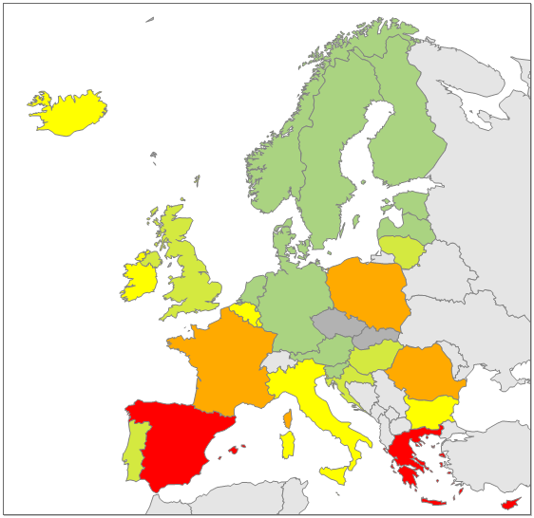

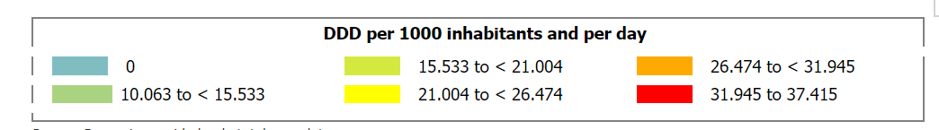
Geographical distribution of the consumption of antibacterials for systemic use (ATC group J01) in the community (primary care sector) in Europe, reporting year 2017

Slide 14
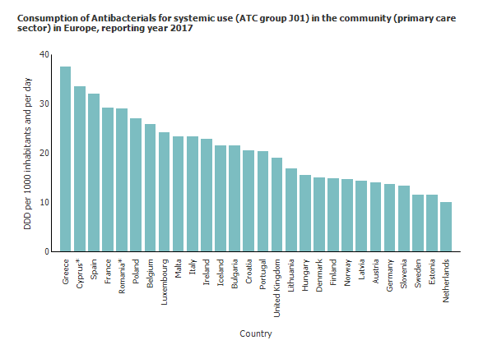
IZVANBOLNIČKA PRIMJENA ANTIBIOTIKA U EUROPI
15./28

Slide 15
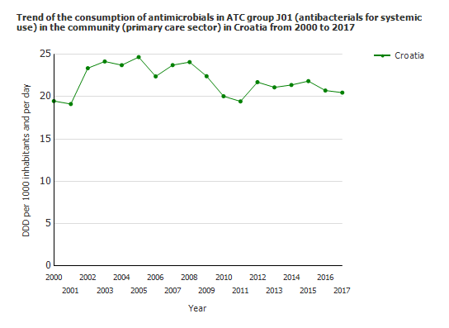
Trend of the consuption in antibacterials for systemic use in the community (primary care sector) in Croatia from 2000-2017.
Simpozij povodom obilježavanja Europskog dana svjesnosti o antibioticima i Svjetskog tjedna svjesnosti o antibioticima
Zagreb, 16.studenoga 2018.
Courtesy of Prim. Marina Payer-Pal, Institute for Public Health of Međimurje County, Croatia
Notes:
Potrošnja antibakterijskih lijekova po DDD/TSD je stabilna i uz manje oscilacije u promatranom razdoblju prosječno godišnje iznosi 23,6 DDD/TSD. Potrebno je istaknuti činjenicu da je, nakon relativno visoke potrošnje antibiotika u
90-tim godinama prošlog stoljeća, početkom i tijekom prvog desetljeća ovog stoljeća
prisutan umjereni trend smanjenja potrošnje antibiotika. Problemi povezani s rezistencijom
antibiotika povećavaju potrebu praćenja korištenja antibakterijskih lijekova tijekom
vremena. Hrvatska se ubraja u europske zemlje s umjereno visokom potrošnjom antibiotika i
posljedično visokim stopama rezistencije na mnoge antibiotike.
15

Slide 16
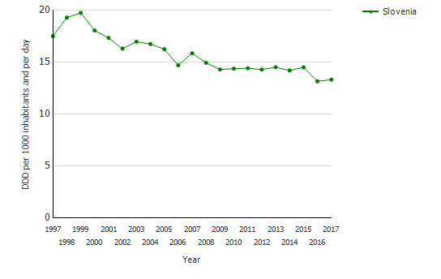
Trend of the consuption in antibacterials for systemic use in the community (primary care sector) in Slovenia from 1997-2017.

Slide 17
Simpozij povodom obilježavanja Europskog dana svjesnosti o antibioticima i Svjetskog tjedna svjesnosti o antibioticima
Zagreb, 16.studenoga 2018.
Trend of the consumption of antibacterials for systemic use in the community (primary care sector) in Croatia, Slovenia and Netherlands from 1997 to 2017
Courtesy of Prim. Marina Payer-Pal, Institute for Public Health of Međimurje County, Croatia

Slide 18
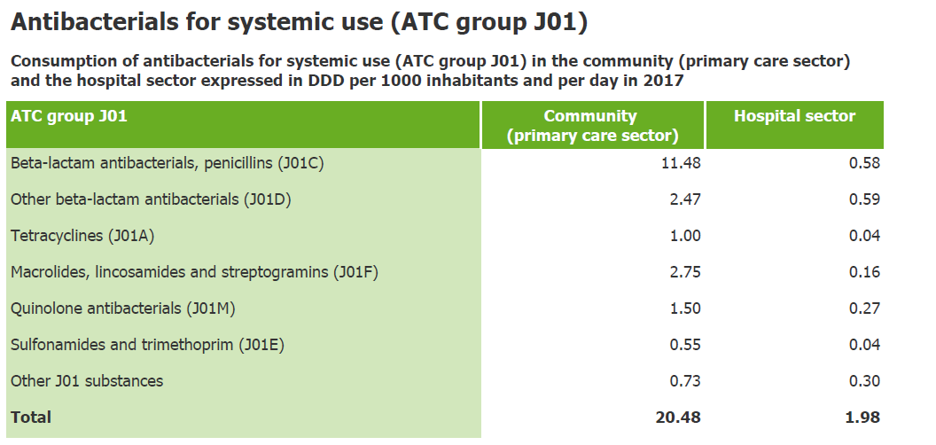
Simpozij povodom obilježavanja Europskog dana svjesnosti o antibioticima i Svjetskog tjedna svjesnosti o antibioticima
Zagreb, 16.studenoga 2018.
Courtesy of Prim. Marina Payer-Pal, Institute for Public Health of Međimurje County, Croatia

Slide 19
Izvanbolnička (ambulantna) potrošnja antibiotika
2001. - 2017.
- po klasama
Simpozij povodom obilježavanja Europskog dana svjesnosti o antibioticima i Svjetskog tjedna svjesnosti o antibioticima
Zagreb, 16.studenoga 2018.
Courtesy of Prim. Marina Payer-Pal, Institute for Public Health of Međimurje County, Croatia

Slide 20
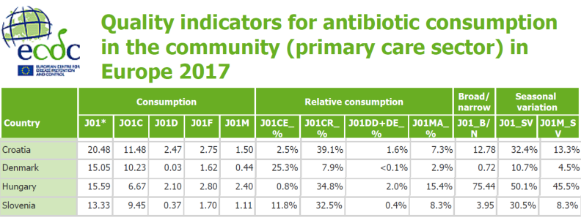
Indikatori kvalitete ambulantne potrošnje antibiotika u Europi
2017. g.
Simpozij povodom obilježavanja Europskog dana svjesnosti o antibioticima i Svjetskog tjedna svjesnosti o antibioticima
Zagreb, 16.studenoga 2018.
Courtesy of Prim. Marina Payer-Pal, Institute for Public Health of Međimurje County, Croatia

Slide 21
Ambulantna potrošnja u 2017. g.
- ”Top 5” antibiotika
DDD/TSG
Simpozij povodom obilježavanja Europskog dana svjesnosti o antibioticima i Svjetskog tjedna svjesnosti o antibioticima
Zagreb, 16.studenoga 2018.
Courtesy of Prim. Marina Payer-Pal, Institute for Public Health of Međimurje County, Croatia

Slide 22
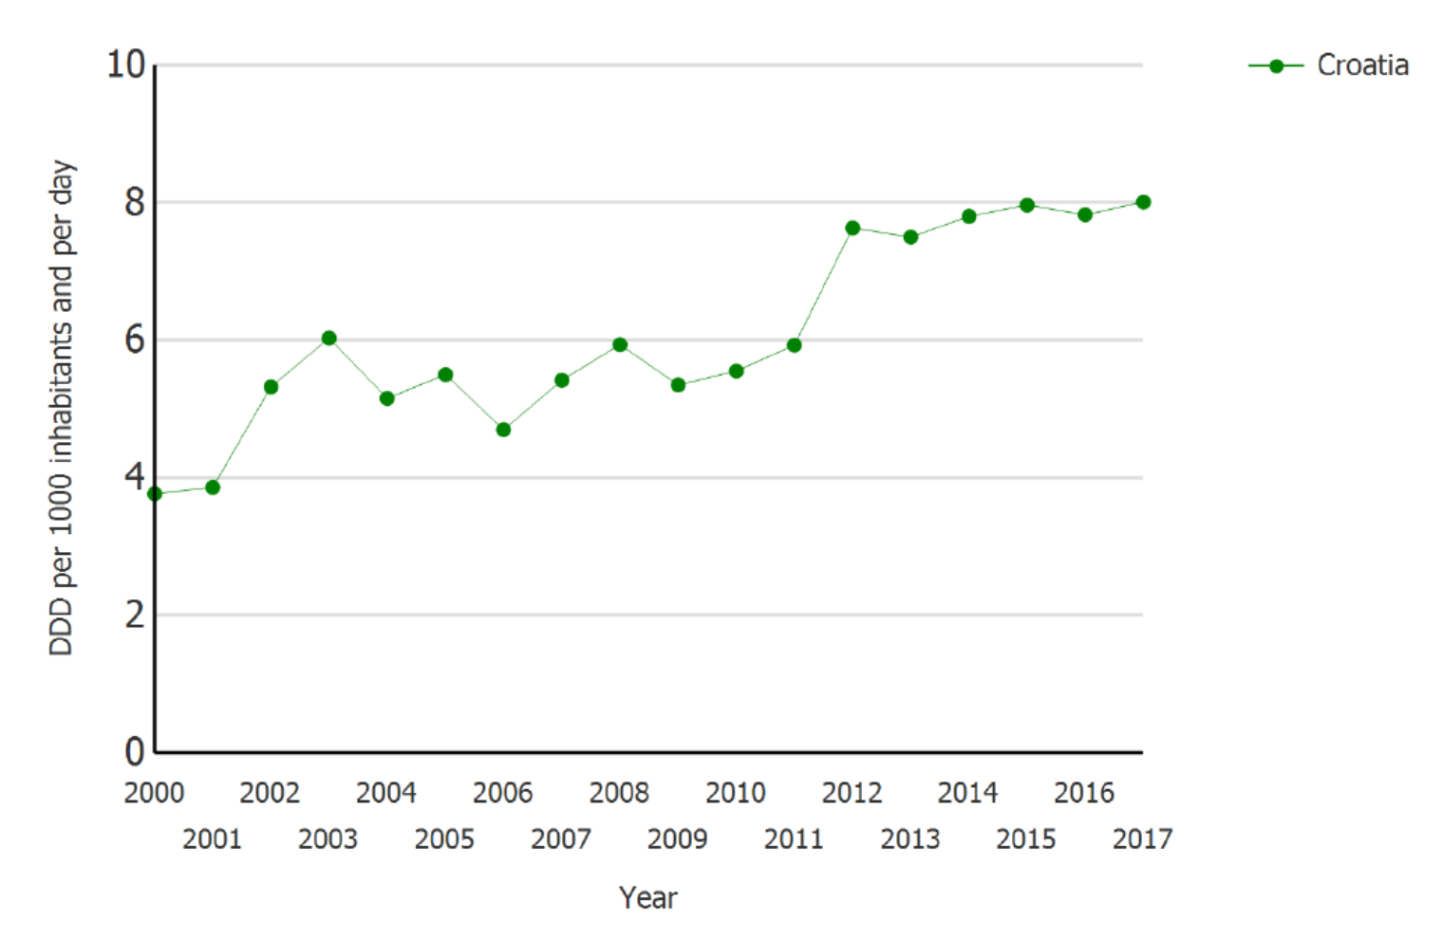

Simpozij povodom obilježavanja Europskog dana svjesnosti o antibioticima i Svjetskog tjedna svjesnosti o antibioticima
Zagreb, 16.studenoga 2018.
Ambulantna potrošnja antibiotika
ATC J01CR – kombinacija penicilina sa širokim
spektrom i inhibitora beta-laktamaze – 2000-2017
Courtesy of Prim. Marina Payer-Pal, Institute for Public Health of Međimurje County, Croatia

Slide 23
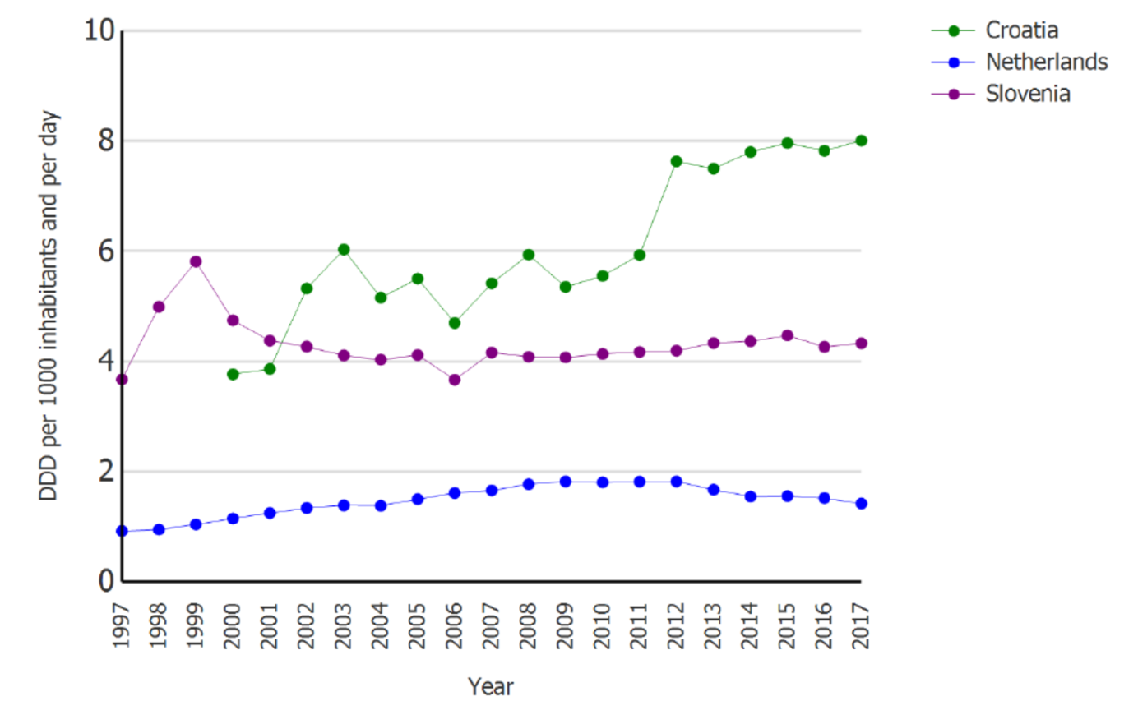
Simpozij povodom obilježavanja Europskog dana svjesnosti o antibioticima i Svjetskog tjedna svjesnosti o antibioticima
Zagreb, 16.studenoga 2018.
Ambulantna potrošnja antibiotika
ATC J01CR – kombinacija penicilina sa širokim
spektrom i inhibitora beta-laktamaze
Courtesy of Prim. Marina Payer-Pal, Institute for Public Health of Međimurje County, Croatia

Slide 24
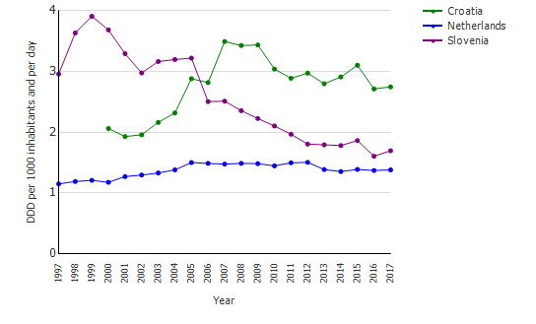
Simpozij povodom obilježavanja Europskog dana svjesnosti o antibioticima i Svjetskog tjedna svjesnosti o antibioticima
Zagreb, 16.studenoga 2018.
Trend of the consumption of antimicrobials in ATC group J01F (macrolides, lincosamides and streptogramins) in the community (primary care sector) in Croatia, Slovenia and Netherlands from 1997 to 2017
Courtesy of Prim. Marina Payer-Pal, Institute for Public Health of Međimurje County, Croatia

Slide 25
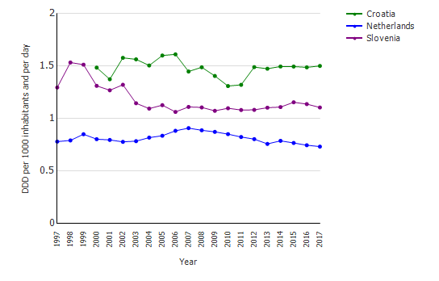
Simpozij povodom obilježavanja Europskog dana svjesnosti o antibioticima i Svjetskog tjedna svjesnosti o antibioticima
Zagreb, 16.studenoga 2018.
Trend of the consumption of antimicrobials in ATC group J01MA (fluoroquinolones) in the community (primary care sector) in Croatia, Slovenia and Netherlands from 1997 to 2017
Courtesy of Prim. Marina Payer-Pal, Institute for Public Health of Međimurje County, Croatia

Slide 26
Simpozij povodom obilježavanja Europskog dana svjesnosti o antibioticima i Svjetskog tjedna svjesnosti o antibioticima
Zagreb, 16.studenoga 2018.
Izvanbolnička potrošnja po županijama antibakterijskih lijekova za sustavnu upotrebu (J01) u 2016. godini u DDD/TSD
Courtesy of Prim. Marina Payer-Pal, Institute for Public Health of Međimurje County, Croatia

Slide 27
Antimicrobial stewardship (AS) in outpatient settings
What can we do?
How can we do it?
Who are „we”?

Slide 28

Outpatient AS
The four core elements
commitment
stewardship program interventions
tracking and reporting
education and expertise
Notes:
The four core elements
of outpatient antibiotic stewardship are commitment, action for policy and practice, tracking and reporting, and education and expertise.
28

Slide 29


1. Commitment
commit to AS by displaying a public statement in patient care areas describing adherence to appropriate antibiotic use
RCT, more than 950 adult visits for ARI, displaying commitment letters reduced inappropriate ATB prescribing by nearly 20%*
„no inappropriate ATB prescribing!”
*Meeker D, Intern Med. 2014;174(3):425.
Notes:
The intervention consisted of displaying poster-sized commitment letters in examination rooms for 12 weeks. These letters, featuring clinician photographs and signatures,stated their commitment to avoid inappropriate antibiotic prescribing for ARIs.

Slide 30

1. Commitment
Healthcare system leadership can demonstrate commitment to AS by identifying a leader to direct stewardship activities
in job descriptions
promotion criteria
communicating with all clinic staff members

Slide 31
2. Stewardship program interventions
Identify high-priority condition(s):
for which ATB are not indicated
i.e. acute bronchitis, common cold
for which antibiotics might be indicated but are overdiagnosed
i.e. GAS pharyngitis treatment without testing for pathogen
for which might be indicated but the wrong class, agent, dose, or duration is selected
acute otitis media
for which watchful waiting or delayed prescribing is appropriate
i.e. acute uncomplicated sinusitis

Slide 32
2. Stewardship program interventions
Clinician interventions:
identify barriers that lead to deviation from the best practices
providers’ perceptions of patients’ desire to recieve antibiotics*
establish standards for antibiotic prescribing
implementation on national guidelines
watchful waiting or delayed prescribing for patients with conditions that usually resolve without treatment
i.e. sinusitis, GAS pharyngitis
reduce innappropriate diagnostic testing that leads to inappropriate ATB treatment
i.e. urine cultures in the absence of pyuria
*Francois Watkins LK, et al. MMWR 2015;64(28):767.
Sanchez GV. Emerg Infect Dis. 2014;20(12):2041.

Slide 33

2. Stewardship program interventions
Leadership interventions:
provide clinician communications skills training
discussing benefits and harms of antibiotic use, management of self-limiting conditions
provide support for antibiotic decision-making with clinical workflow*
require written justification in the medical record for all antibiotic prescriptions
*Jenkins TC, et al. Am J Med. 2013;126(4):327.

Slide 34

3. Tracking and reporting
Also called audit and feedback
Tracking and reporting for high priority conditions can be used to assess for appropriate
diagnostic criteria were met
ATB for the assigned diagnosis
duration of ATB treatment
Tracking of individual clinician prescribing
Comparison of clinician’s performance
top- and bottom-performing peers
Tracking and reporting the complications of antibiotic use (C.difficile infections, drug interactions)

Slide 35


4. Education and expertise
clinic and healthcare system leaders can facilitate clinician education
formal education training
continuing education opportunities
clinicians can educate patients*
no ATB for viral infections
education for potentional harms of ATB
provision of patient education materials
*Mangione-Smith R, et al. Ann Fam Med. 2015;13(3):221.

Slide 36
SPECIAL SETTINGS in outpatient AS
Emergency departments
An involved pharmacist can assist ED clinicians in antibiotic choice*
Nursing homes
Outpatient dialysis units
clinical pathways targeting line-associated bacteremia and vascular access site infections (vancomycin)
Dentist offices
10% of outpatient ATB use
restrictive guidelines for antibiotic prophylaxis prior to dental procedures
*Bishop BM. Pharm Pract. 2016;29(6):556.

Slide 37
My vision
University Hospital for Infectious Diseases (UHID)
„Hospital - friend of antibiotics” ☺
Open doors days for antibiotic prescribers
Small groups education
Ambulance for antibiotics!
Start with UHID and Hospital in Šibenik
In every Clinical hospital center and Clinical hospitals in Zagreb
Then in all hospitals in Croatia

Slide 38


