Slide 1
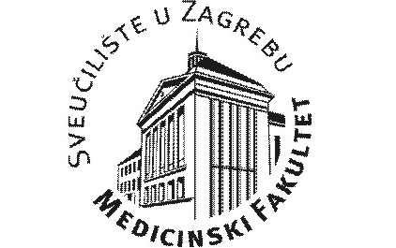

ULOGA INFEKTOLOGA U RACIONALIZACIJI ANTIMIKROBNOG LIJEČENJA
Zašto infektolog mora biti voditelj A-tima i povjerenstva
Prof. dr. sc. Bruno Baršić, dr. med.

Slide 2
Elementi racionalne antimikrobne terapije
Potrebna
  DIJAGNOZA
Pravovremena
Učinkovita
  Izbor, doza, nuspojave
  Poznavanje učinka u selekcioniranih bolesnika
  Poznavanje PK/PD odnosa
    Kritični bolesnici
  Rezultati različiti u pojedinim podgrupama bolesnika ovisno o patofiziološkim poremećajima
    Temeljito poznavanje infektološke bolesti

Slide 3
ATB tim
Timski rad je zahtjev današnje medicine
ATB tim
  Infektolog
  Klinički mikrobiolog
  Klinički farmakolog
  Klinički farmaceut
  Kliničar

Slide 4
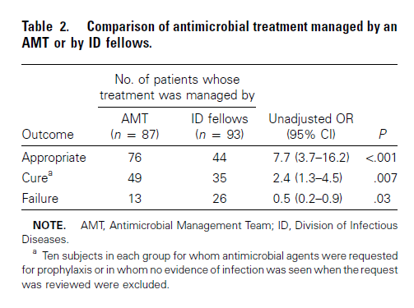
Tim je bolji od pojedinca
Clinical Infectious Diseases 2001; 33:289–95
ATB tim (ID+ klinički farmaceut)
Pojedinac: Subspecijalizant infektologije

Slide 5
Defensive medicine among antibiotic stewards: the international ESCMID AntibioLegalMap survey
85.0%, 525/618 reported some defensive behaviour in antibiotic prescribing
These behaviours were independently associated with being younger than or equal to 35 years and sometimes or often worried about liability.
The preferred measures to reduce fear and defensive behaviours were having local guidelines and sharing decisions through teamwork
J Antimicrob Chemother. 2018 Apr 4

Slide 6
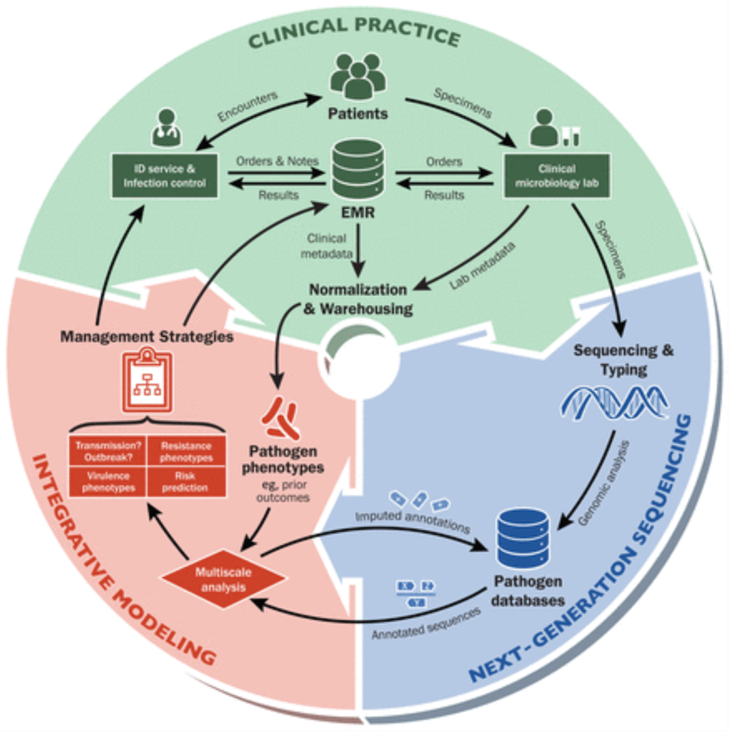
From: How Next-Generation Sequencing and Multiscale Data Analysis Will Transform Infectious Disease Management
Clin Infect Dis. 2015;61(11):1695-1702. doi:10.1093/cid/civ670
Notes:
Figure 1. A learning health system for infectious diseases. Next-generation sequencing (NGS) technologies now permit routine genomic analysis of clinical microbiology specimens. When integrated with pathogen phenotypes derived from clinical metadata in electronic medical records (EMRs) and laboratory metadata, we can generate predictive models for pathogen transmission, outbreaks, drug resistance, virulence, and risk factors for infection or critical outcomes that are specific to the health system and its patient population. If management strategies are formulated from these predictions and sent to infectious disease (ID) physicians and hospital infection control, a continuous loop of data analysis, application, and model refinement is created.
6

Slide 7
Značenje infektologa
Konzilijarna služba
  Niža smrtnost OR=0.87; 95% CI, .83 do .91
  Niža učestalost ponovnih prijema OR, 0.96; 95% CI, .93 do .99)
  Kraći boravak 3.7% 95% CI, −5.5% to −1.9%
Medicare
101 991 bolničkih boravaka ID+
170 336 ID-
Clinical Infectious Diseases 2014;58(1):22–8

Slide 8
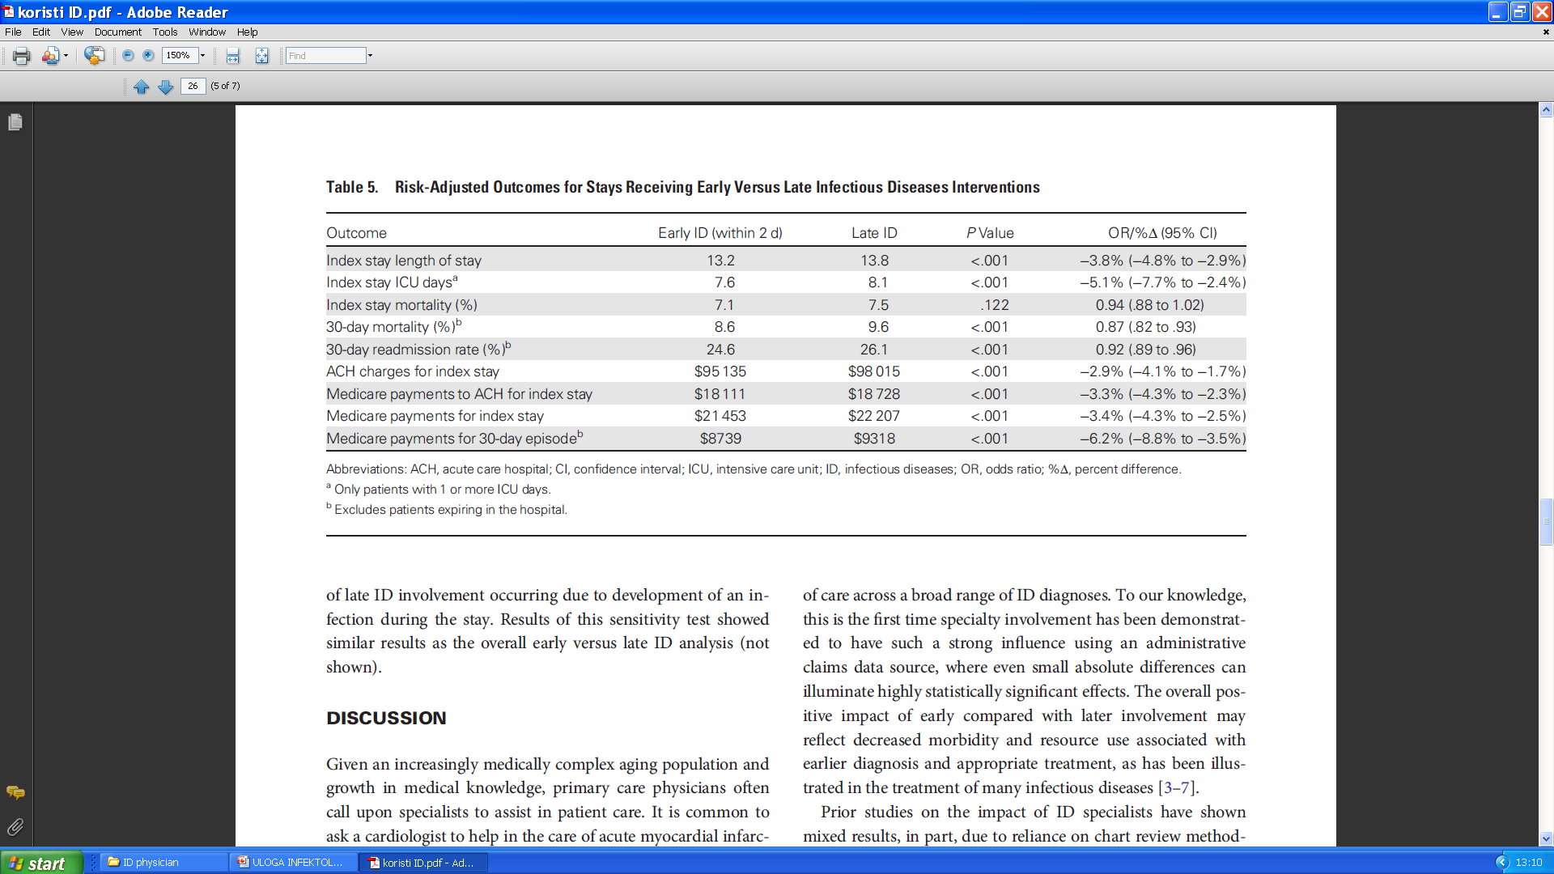
Potrebna je rana intervencija
Clinical Infectious Diseases 2014;58(1):22–8

Slide 9
ID konzultacija kod kriptokoknog meningitisa
100 bolesnika ID+
47 bolesnika ID –
Ishod:
  Češća učestalost ispravne terapije
  Dulja primjena
  Češća LP
  Bolji ishod liječenja
Clinical Infectious Diseases® 2017;64(5):558–64

Slide 10
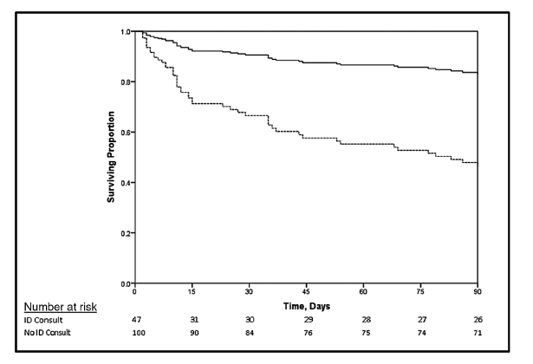
ID konzultacija povećava preživljavanje bolesnika
Kriptokokni meningitis kod non HIV bolesnika
Clinical Infectious Diseases® 2017;64(5):558–64

Slide 11
Impact of an antimicrobial stewardship program on outcomes in patients with community-acquired pneumonia admitted to a tertiary community hospital
      Am J Health Syst Pharm. 2018 Jun 1;75(11 Supplement 2):S42-S50
Feasibility of Antimicrobial Stewardship (AMS) in Critical Care Settings: A Multidisciplinary Approach Strategy
      Med Sci (Basel). 2018 May 25;6(2)
Antimicrobial stewardship in the treatment of skin and soft tissue infections
      Am J Infect Control. 2017 Nov 1;45(11):1203-1207
A Statewide Antibiotic Stewardship Collaborative to Improve the Diagnosis and Treatment of Urinary Tract and Skin and Soft Tissue Infections
      Clin Infect Dis (in press)

Slide 12
Infectious disease consultation and microbiologic surveillance for intensive care unit trauma patients: a pilot study
ID - 154 pts vs. ID+ 141
ID consultation was associated with a 49% increased odds that an infection diagnosis was microbiologically based (P=.006)
45% reduction mean days of prophylactic antibiotics
57% reduction of antibiotics costs per hospitalized day (P=.0008)
Clin Infect Dis. 2001 Dec 15;33(12):1981-9

Slide 13
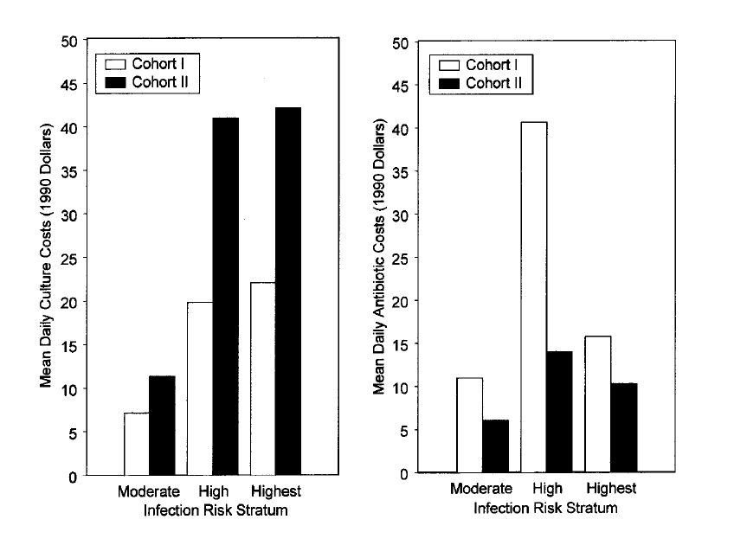
Clin Infect Dis. 2001 Dec 15;33(12):1981-9

Slide 14
Kurikulum iz infektologije
Boravak na kliničkim odjelima

Slide 15
Kurikulum iz infektologije
Sati na spec. studiju

Slide 16
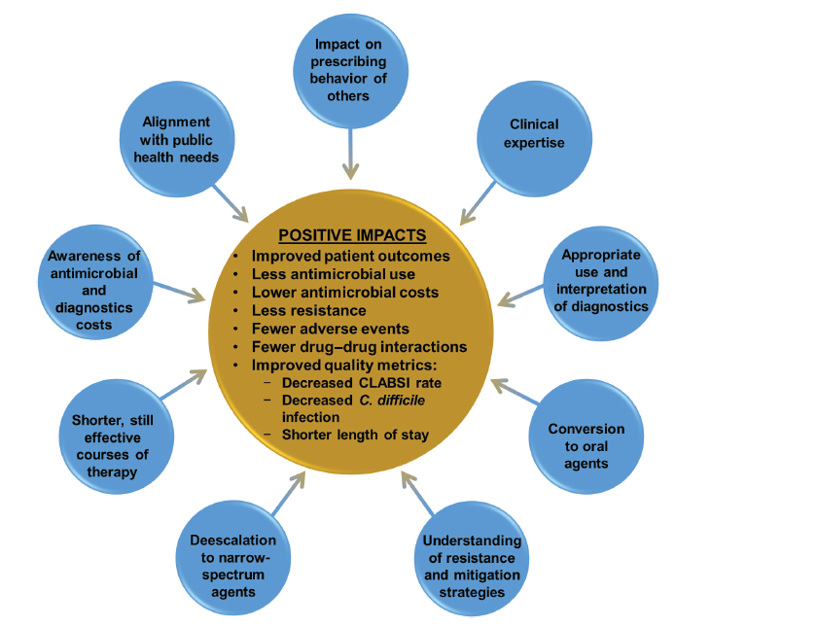
Clinical Infectious Diseases® 2018;66(7):995–1003
Notes:
Uloga infektologa

Slide 17
ATB tim
BI tim

Slide 18
Veliki posao za infektološku struku
Antimicrobial Stewardship Training for Infectious Diseases Fellows: Program Directors Identify a Curriculum Need
  Clin Infect Dis. 2018 Apr 16
U Hrvatskoj isto potrebne promjene u edukaciji infektologa i organizaciji službe
  Antibiotici
  Djelovanje antibiotika u posebnim uvjetima
  Komunikacija u timu
  Mogućnost supspecijalizacije intenzivne medicine

Slide 19
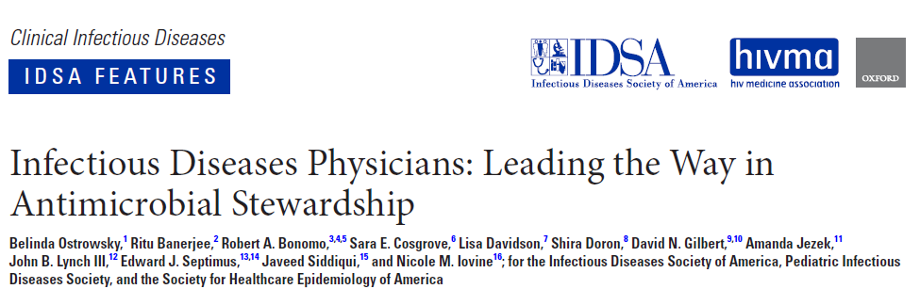
Clinical Infectious Diseases® 2018;66(7):995–1003

Slide 20
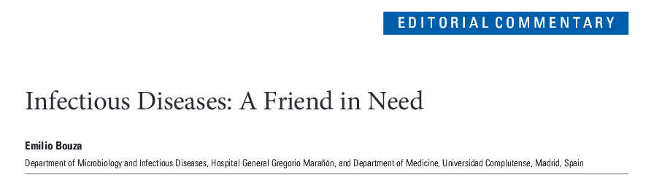
Clinical Infectious Diseases 2014;58(1):29–31

