Slide 1

CLINICAL SOLVING PROBLEM
„I look like a Bart Simpson”
Davorka Dušek, MD

Slide 2
First contact with patient
35 year old patient comes to the ER because of 7 days history of malaise, fever up to 38 °C and icterus
icterus was noted on the day of the examination
Except from icterus pt noticed darker urine and lighter stool 3 days earlier
Pt complains of nausea and abdominal pain
Chief complaint: „I look like a Bart Simpson”
Past medical history significant only for surgery of open tibial fracture 25 years ago
Doesn’t take any medications
Your next step:
a) detailed history, especially social and epidemiologic data and physical examination
b) basic laboratory studies
c) abdominal ultrasound
d) MR of the abdomen
e) all of the above

Slide 3
Correct answer:
a) detailed history, especially social and epidemiologic data and physical examination
b) basic laboratory studies
c) Abdominal ultrasound
d) MR of the abdomen
e) all of the above

Slide 4
Detailed history and physical exam
Social history: drinks 6-8 beers on weekends, sometimes takes marijuana
Epidemiologic data: he lives alone in urban area, denies any sick contacts, had unprotected sexual intercourse in the last 3 months
Denies blood transfusion, intravenous drug use, consumption of OTC medication or mushrooms
Physical examination
* skin and sclerae are icteric
* abdomen nontender to palpation, liver palpable 1cm
* remainder of PE unremarkable
Which laboratory/radiologic studies would you perform :
a) CBC
b) glucose, urea, creatinine, bilirubin, AST, ALT, GGT, AP
c) PT, INR
d) abdominal ultrasound
e) all of the above

Slide 5
Correct answer:
a) CBC
b) glucose, urea, creatinine, bilirubin, AST, ALT, GGT, AP
c) PT, INR
d) abdominal ultrasound
e) all of the above

Slide 6
Basic laboratory/radiologic studies
E 5.08, Hb 153, MCV 88.4, WBC 12.3, ne 56, ly 36, mo 4, eo 3, Plt 110
CRP 19.1 mg/L
Glucose 5.4, urea 5.5, creatinine 112, Na 135, K 4.1, Cl 93
Bilirubin 240 (conj 108), AST 4568, ALT 6724, GGT 250, AP 180, LDH 627
PT 0.38, INR 1.62
Abdominal ultrasound:
  hepatoplenomegaly
  gallblader contracted
  biliary tract normal
This patient has:
a) Hepatocelluar pattern of liver tests abnormalities
b) Cholestatic pattern of liver tests abnormalites
c) Decreased synthetic liver function
d) a+c
e) b+c

Slide 7
Patterns of liver tests abnormalities
Hepatocelluar pattern
Cholestatic pattern
Decreased synthetic liver function
d) a+c
e) b+c

Slide 8
Patterns of liver tests abnormalities
Hepatocellular pattern:
• Disproportionate elevation in ALT/AST compared with AP
• Serum bilirubin may be elevated
• Tests of synthetic function may be abnormal
Cholestatic pattern:
• Disproportionate elevation in the AP compared with ALT/AST
• Serum bilirubin may be elevated
• Tests of synthetic function may be abnormal
Isolated hyperbilirubinemia

Slide 9
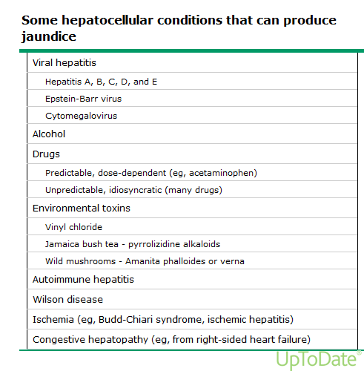

Slide 10
What is the most probable diagnosis
Alcohol induced liver injury
Acute viral hepatitis
Ischemic hepatitis
d) EBV infection
e) hemochromatosis

Slide 11
What is the most probable diagnosis
Alcohol induced liver injury
Acute viral hepatitis
Ischemic hepatitis
d) EBV infection
e) hemochromatosis

Slide 12
Which tests would you do next:
a) HBsAg, IgM anti HBc, anti HBc, anti HBs, HDV IgG
b) IgM anti HAV, HBsAg, IgM anti HBc, anti HCV
c) IgM anti HAV, HBsAg, IgM anti HBc, anti HBc, anti HBs, HBeAg, anti HBe
e) IgM anti HAV, HBsAg, IgM anti HBc, anti HBc, anti HBs, anti HCV, IgM anti HEV, IgG anti HEV

Slide 13
Which tests would you do next:
a) HBsAg, IgM anti HBc, anti HBc, anti HBs, HDV IgG
b) IgM anti HAV, HBsAg, IgM anti HBc, anti HCV
c) IgM anti HAV, HBsAg, IgM anti HBc, anti HBc, anti HBs, HBeAg, anti HBe
e) IgM anti HAV, HBsAg, IgM anti HBc, anti HBc, anti HBs, anti HCV, IgM anti HEV, IgG anti HEV

Slide 14
Following test are positive: HBsAg, IgM anti HBc, anti HBc
What is your diagnosis:
Acute hepatitis B
Acute hepatitis C
Acute hepatitis E
Clinical course and laboratory results in this patient are typical for acute hepatitis B, although sometimes HBsAg and IgM anti HBC can be positive in exacerbation of chronic hepatitis B

Slide 15
Following test are positive: HBsAg, IgM anti HBc, anti HBc
What is your diagnosis:
Acute hepatitis B
Acute hepatitis C
Acute hepatitis E
Clinical course and laboratory results in this patient are typical for acute hepatitis B, although sometimes HBsAg and IgM anti HBC can be positive in exacerbation of chronic hepatitis B

Slide 16
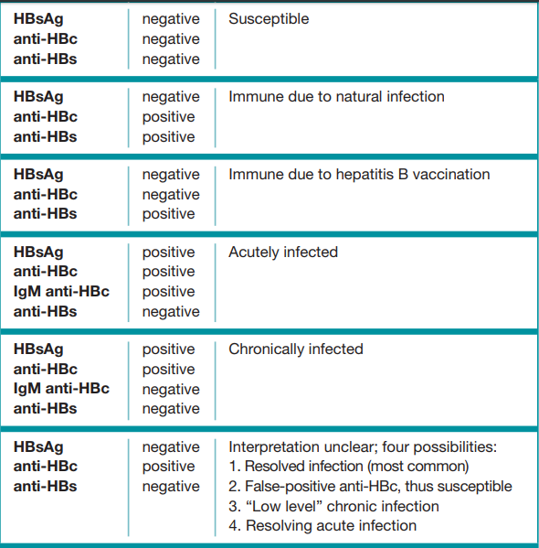
Interpretation of HBV serology (CDC)

Slide 17
Patient management
You recommend follow up in 7 days and symptomatic therapy
You would hospitalize this patient because of signs of coagulopathy
c) You would start therapy with tenofovir
d) You would imediately give fresh frozen plasma
e) b+c

Slide 18
Patient management
You recommend follow up in 7 days and symptomatic therapy
You would hospitalize this patient because of signs of coagulopathy
c) You would start therapy with tenofovir
d) You would imediately give fresh frozen plasma
e) b+c

Slide 19
Which of the following would indicate severe clinical course - progression to liver failure:
a) bilirubin> 150
b) PV 0.2, INR 2.14
c) ALT 6000
d) confusion, lethargy
e) b+d

Slide 20
Which of the following would indicate severe clinical course- progression to liver failure:
a) bilirubin> 150
b) PV 0.2, INR 2.14
c) ALT 6000
d) confusion, lethargy
e) b+d

Slide 21
Treatment of acute hepatitis B
Most patients require only symptomatic therapy
Indications for antiviral therapy (nucleoside analogues) are
* coagulopathy (INR>1.5) OR
* protracted course OR
* signs of acute liver failure
treatment with tenofovir disoproxil, entecavir or lamivudin is recommended
Aniviral treatment does not increase the risk of chronicity
EASL guidelines, 2017.

Slide 22
Further clinical course
Patient recoveres without complications. Which of the following is correct:
Therapy with tenofovir should be stopped after one month
Patient will most likely have chronic hepatitis B
You should test this patient also for HIV
After disease regression, you will recomend vaccination against HAV
c+d

Slide 23
Further clinical course
Patient recoveres without complications. Which of the following is correct:
Therapy with tenofovir should be stopped after one month
Patient will most likely have chronic hepatitis B
You should test this patient also for HIV
After disease regression, you will recomend vaccination against HAV
c+d

