Slide 1

Clinical case
Božana Miklaušić
Klaudija Višković
Denis Marušić
Saša Andrašević
University Hospital for Infectious Diseses Zagreb

Slide 2
Current illness (13.03.2018.)
Female, 33 years, lives in Zagreb
3 days nausea and vomiting (5x daily), many waterproof stolls with mucos (10x daily)
3 days fever 38ᵒC with chills, malaise, weakness
intermittent dull pain in the upper abdomen, loss of appetite
Neat urination. No rash
Last period was 2 weeks ago

Slide 3
Before this disease, the patient was taking an antibiotic to treat tooth infection (amoxicillin- clavulanic acid 2g/ daily / 7 days)

Slide 4
History
From the age of 18 years:
Dysmenorrhoea, polycystic ovaries
Obesitas, irregular hyperglicemia, hyrsutism
Chronic gastritis, anemia
Arterial hypertension, supraventricular tachycardia
Psyhosis
Cholecystectomy and apendectomy

Slide 5
Medications: torasemid, ramipril, bisoprololum,metforminum dextriferronum, pantoprazolum, quetiapinum, acidum valproicum, promazinum, biperiden
No allergies
Epidemiologic history: lives in town (Zagreb), in flat with parents, no sick contacts, no animal contact, no travel

Slide 6
Physical examination (13.03.2018.)
BP 105/90 mmHg, pulse 118/min, Tax 37.9°C, RR 16/min, satO2 97%
Alert, oriented, febrile, malaised. Meningeal signs negative. Skin: no rash or bleeding. Throat: no exudate. Lungs, heart, extremities- unremarkable
Abdomen: soft, non tender to palpation, peristalsis is heard, without organomegaly

Slide 7
Differential diagnosis
Infectious etiology?
Non- infectious etiology?

Slide 8
Laboratory results (13.03.2018.)
CRP 16.5
WBC 8.2 (seg 67, ly 22, mo 10, ba 1)% Er 5.22, Hb 151, Hct 0.439, MCV 84.1, Tr 251
glucose 5.9, urea 3.4, creatinine 84, bilirubin 12, AST 50, ALT 47, GGT 58, AF 64, LDH 193, Na 137, K 4.1, Cl 100
Urine: prot 1, glucose 3, sediment: 20-30 L, 3-5 Er
Blood culture- sterile. Urine culture- sterile.
Stool- bact. negative. Stool- toxin Clostridium difficile negative

Slide 9
Therapy (13.03.2018.)
Parenteral rehydration, acetamynophen, ibuprofen, metoclopramide
During emergency observation, patient was subfebrile to 37.5ᵒC, did not vomit, no nausea, no stool, no abdominal pain
Patient was released home

Slide 10
Current illness (15.03.2018.)
Two days after discharge - many waterproof stolls again, with mucos (20x daily); nausea, no vomiting
Currently patient has intense pain in the upper abdomen that spreads toward the belly

Slide 11
Physical examination (15.03.2018.)
Tax 36.8 °C, BP 110/80 mmHg, pulse 111/min, RR 16/ min, satO2 97%, GCS 15
Alert, oriented, malaised, hypotensive, pale, fuzzy, difficult general condition
Abdomen was distended, tense, and tender with marked guarding and rigidity in the area above the belly. No other obvious lumps or organomegaly was detected. No intestinal peristalsis was heard

Slide 12
Laboratory results (15.03.2018.)
CRP 7.6
WBC 7.6 (seg 63, ly 32, mo 5)%, Er 4.7, Hb 137, Hct 0.4, Tr 289
glucose 6.2, urea 2.4, creatinine 74, Na 139, K 3.7, Cl 103, bilirubin 7, AST 45, ALT 66, GGT 71, AF 73, LDH 205
TP 64, alb 36.9
PV 0.93, D - dimer 0.63, fibrinogen 4.4

Slide 13
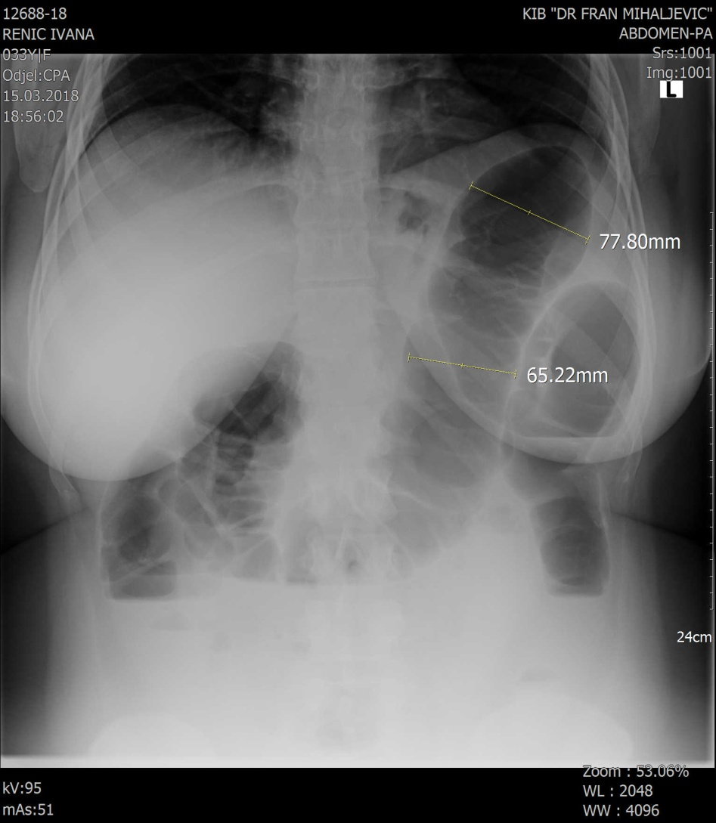
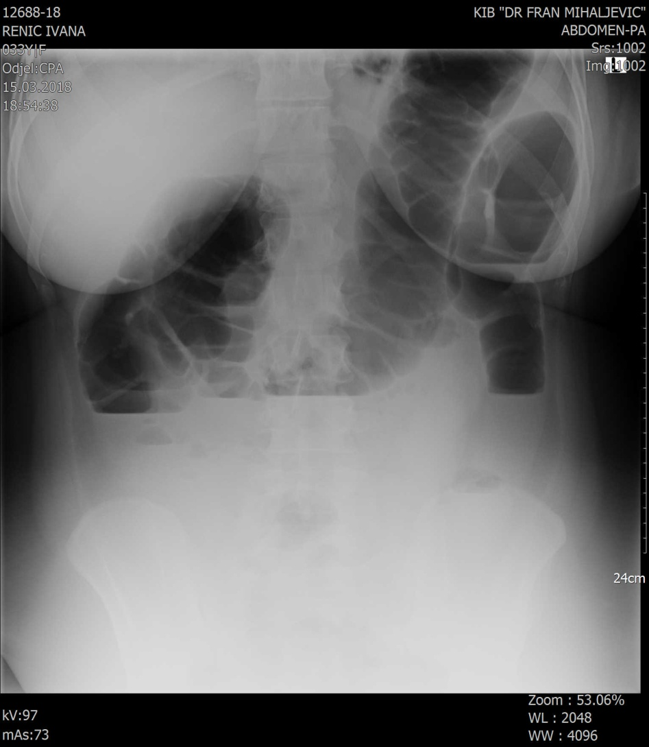
Plain abdominal X-rays performed on March 16 2018
extended large bowel with air-fluid levels

Slide 14
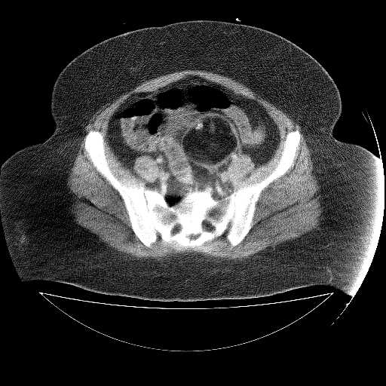
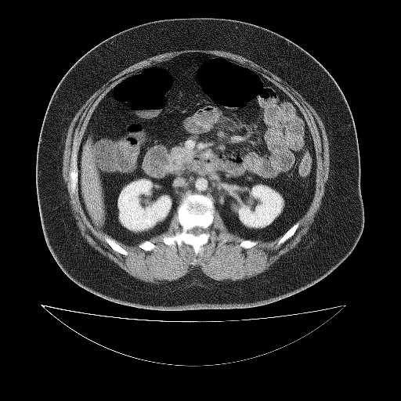
Abdominal computer tomography, performed on March 16, 2018
Sharply demarcated mass containing fat, soft tissue and calcification was seen in pelvis, consistent with ovarian teratoma
Large bowel distension and air-fluid levels

Slide 15
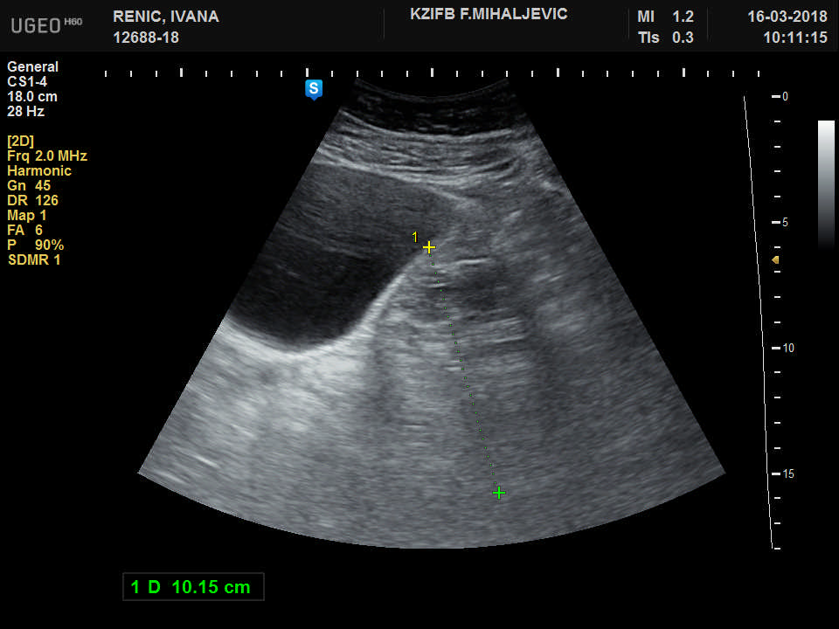
Abdominal ultrasound performed on March 16, 2018
Abdominal ultrasound revealed a large heterogeonus pelvic mass

Slide 16
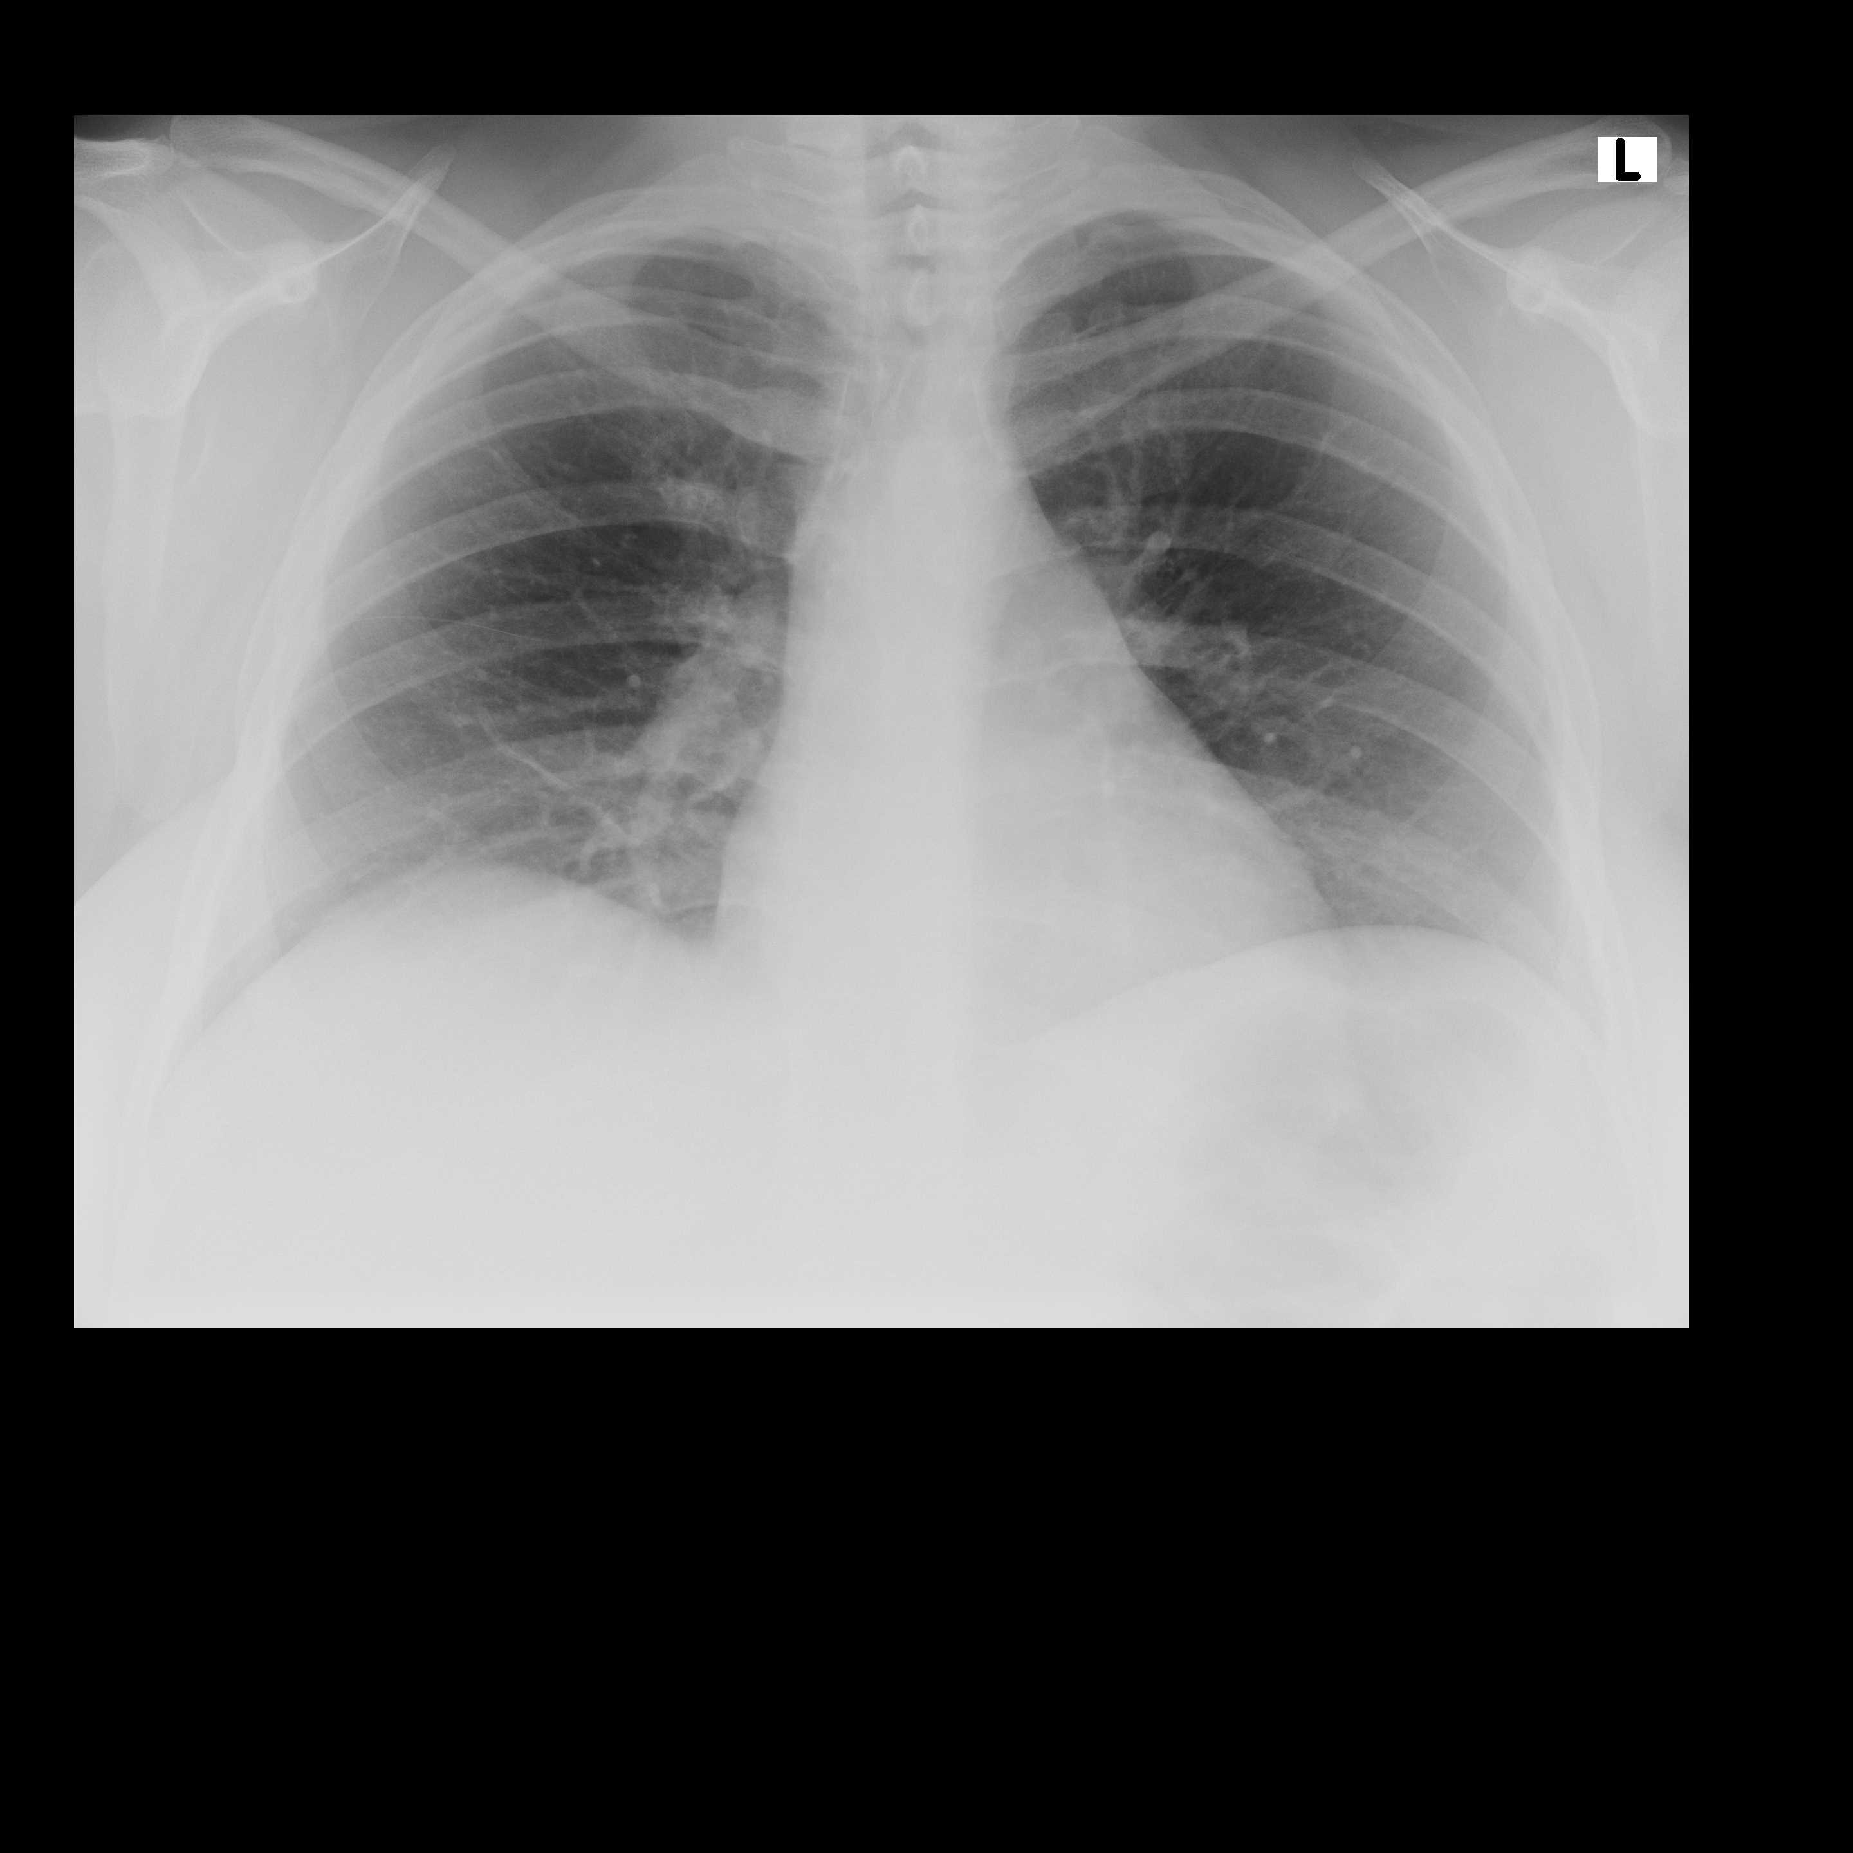
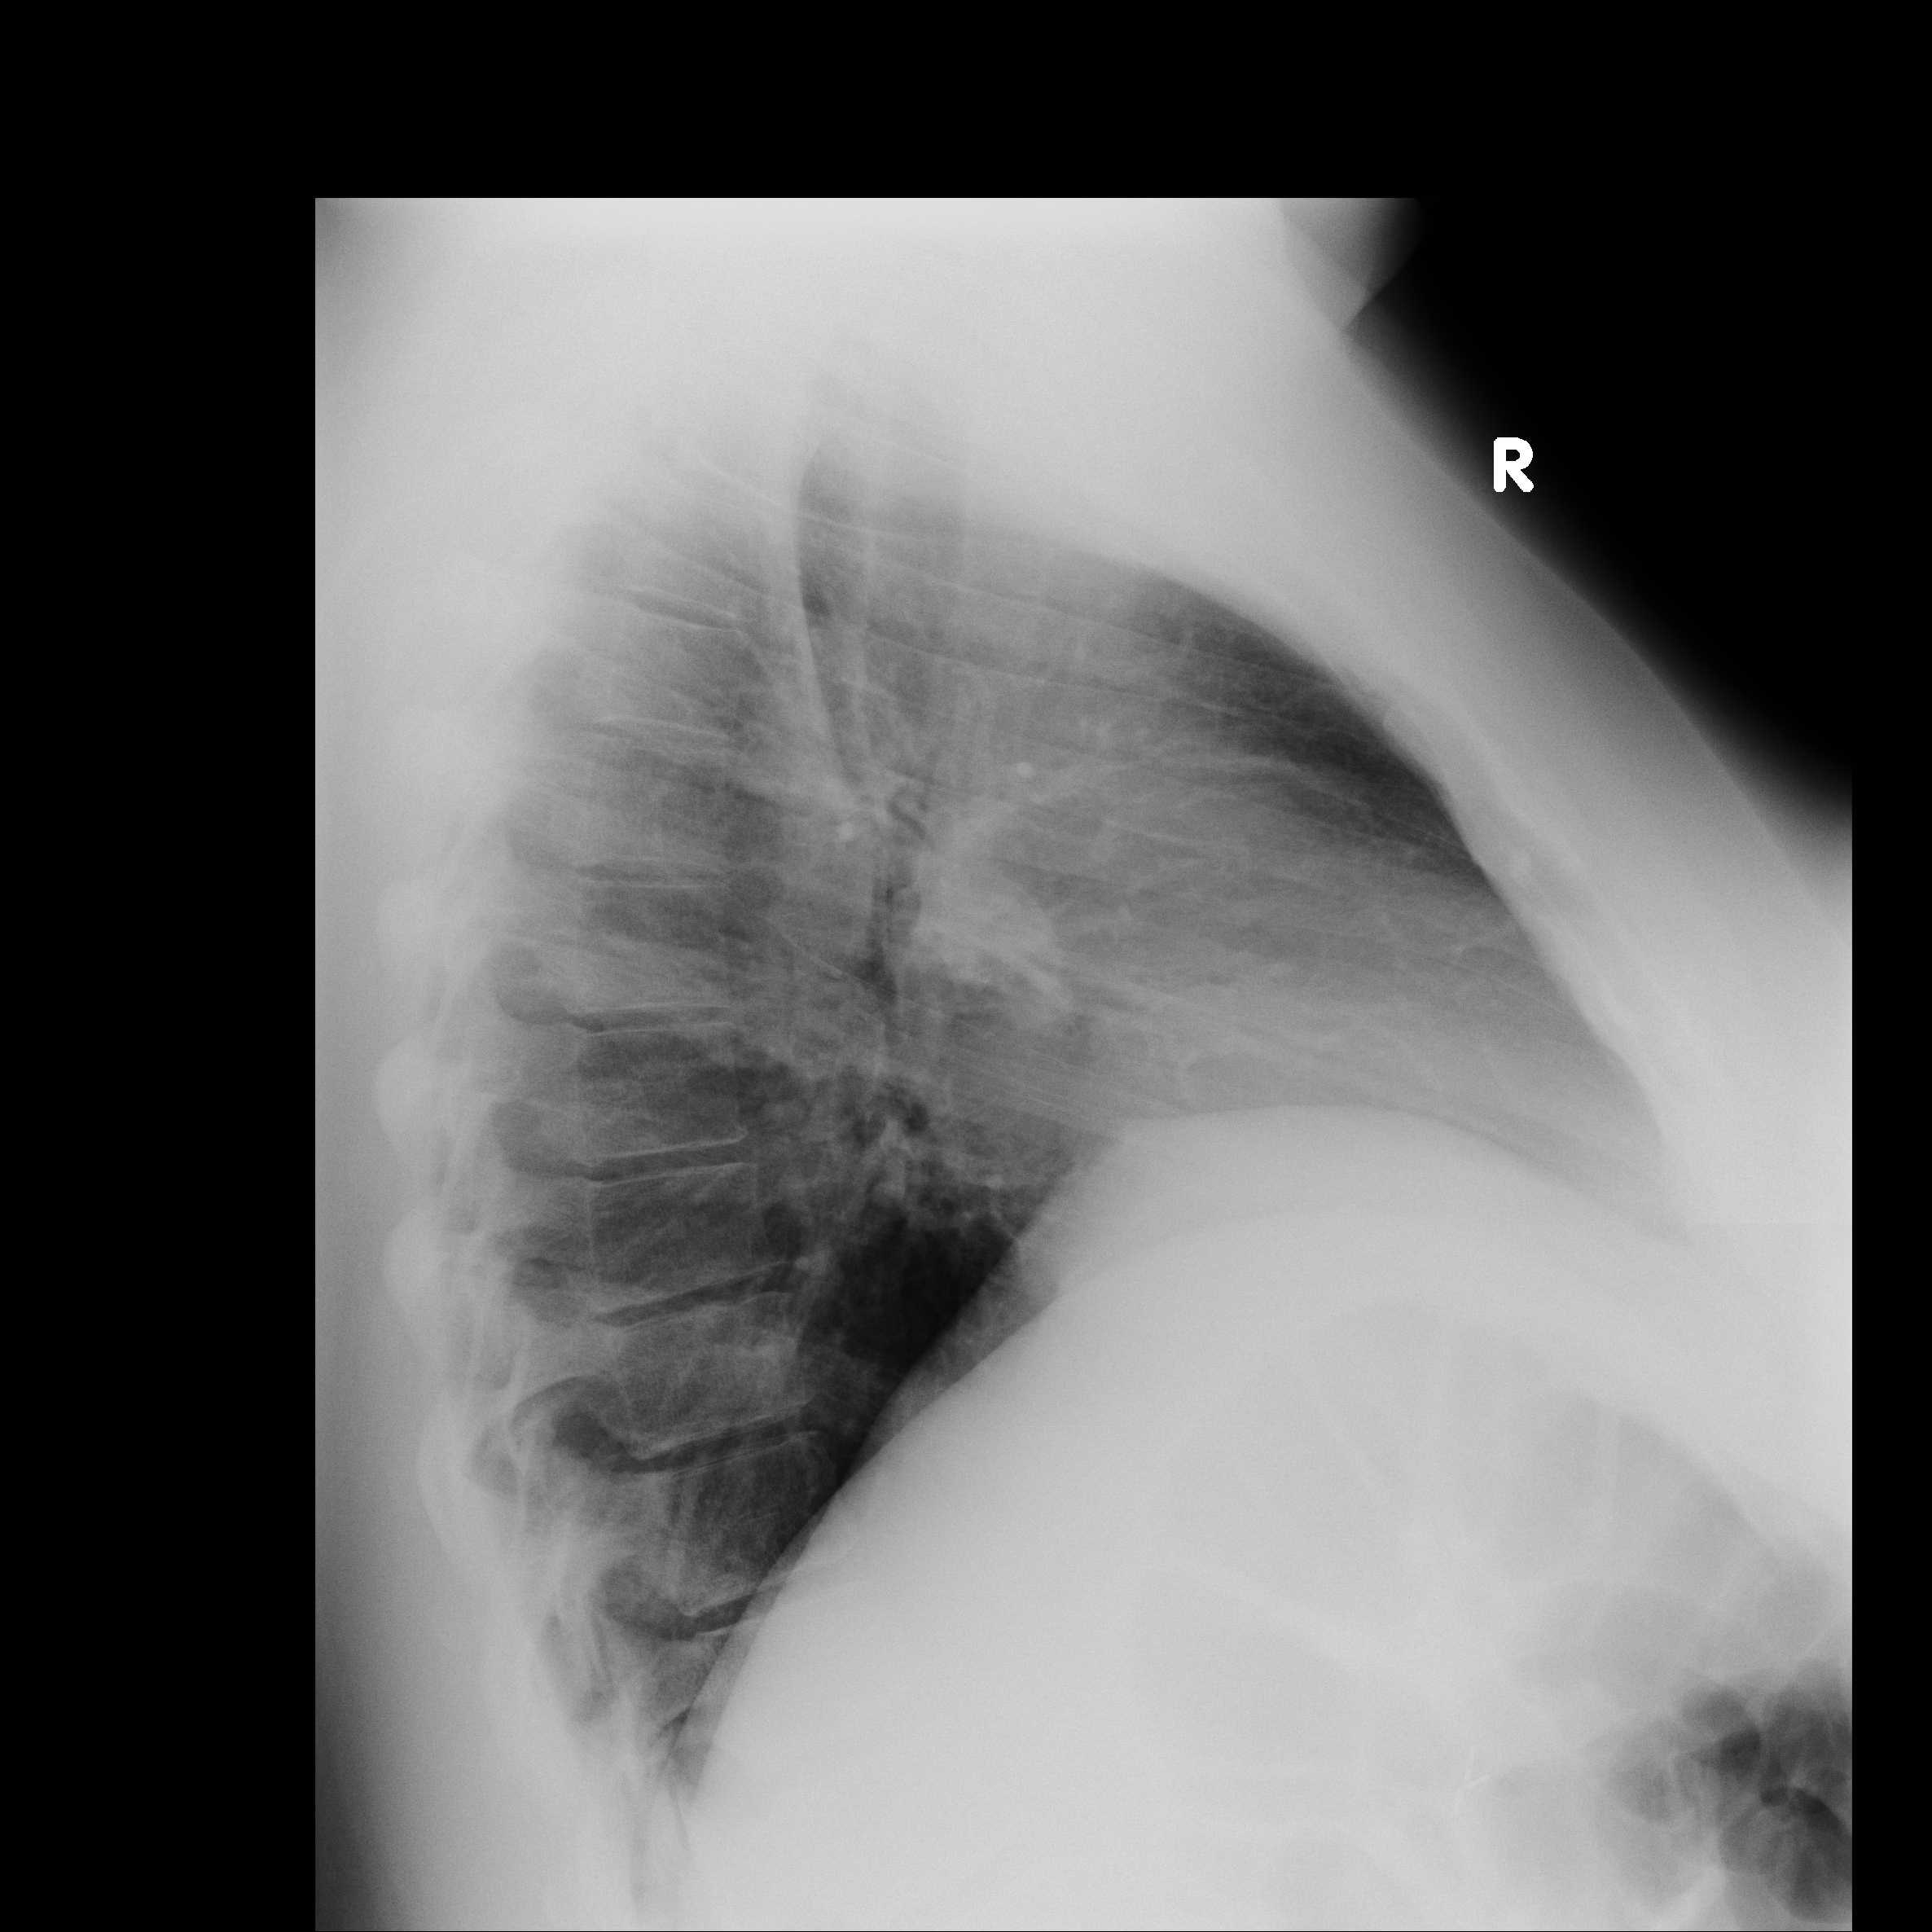
Thoracic chest X-rays performed on March 16,2018-unremarcable

Slide 17
Radiological criteria for bowel mechanical obstruction (Plavšić B. Radiologija probavnog kanala, Školska knjiga Zagreb, 1989.)
The most confident sign of mechanical ileus:
- The bowel distension is oral from obstruction
- The sudden transition to the collapsed bowel loops is
above the site of obstructin
- Liquid and gas bowel levels immediately appears above the site of obstruction
Thin bowel extension> 3cm
Growth of the colon> 5cm
If a patient can not stand: An x-ray chart on the left side with the horizontal central beam air

Slide 18
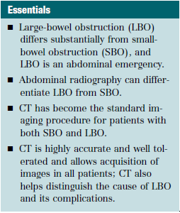
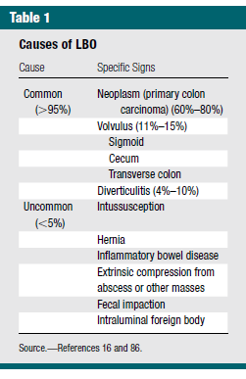
Radiology: Volume 275: Number 3—June 2015 n radiology.rsna.org

Slide 19
Ginecology (KBC Zagreb)
The patient underwent exploratory laparotomy with the diagnosis of peritonitis
On exploration, a large cca 8 cm teratoma arising from the left ovary. The teratoma consisted of hair and cartilage along with foul-smelling fluid. Left-sided oophorectomy with excision of teratoma was done
Histopathology revealed mature dermoid with inflammatory reaction. There was no evidence of any malignancy. Postoperatively serum alpha-fetoprotein was 7.4 ng/mL
Postoperative course was uneventful

Slide 20
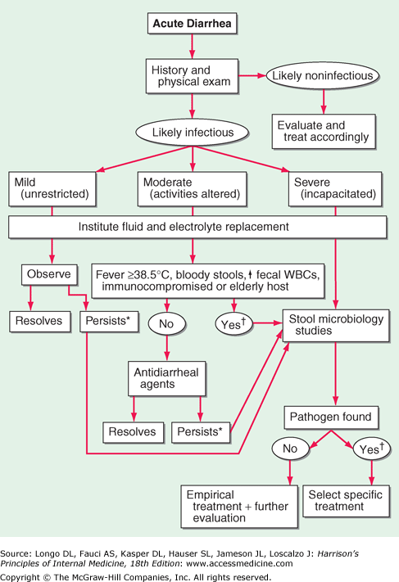
Conclusion 1:
Acute gastroenterocolitis is NOT always an infectious etiology

Slide 21
Conclusion 2: TERATOMA
The word “teratoma” is derived from Greek work “teraton” meaning monster
Tumor growing from embryonic cells
In generative women, the most common are benign forms, <1% malignant
It is most commonly reported due to menstrual cycle disorders, metorrhagia, or accidental
Complications of ovarian teratoma include torsion, rupture, infection, and malignant change

Slide 22
Anti NMDAR encephalitis
1997. the first described cases, and 2007. confirmed autoimmune paraneoplastic disorder associated with IgG antibodies directed to the NR1 subunit of N-methyl-D-aspartate receptor
This disease primarily affects young women and is primarily associated with ovarian teratoma
In 70% of patients the disease begins with a prodromal stage (weakness, headache ...) and 77% of patients initially have some psychiatric disorders (psychosis, hallucinations, dyskinesia, tachycardia, arrhythmias, hypersalvation ...)

Slide 23
Anti NMDAR encephalitis
Symptoms last intermittently from several weeks to several years, often has a fast start
The most important for diagnosis is to find anti-NMDAR antibodies in the blood or liquor

Slide 24
Anti NMDAR encephalitis
4 - 6% of patients with isolated psychiatric episodes have anti-NMDAR encephalitis
It is IMPORTANT to seek organic cause in all patients with acute or chronic psychosis in apparently primary psychiatric disorders

