Slide 1
Clinical case
Davorka Dušek
Neven Papić
Ivan Kurelac
Adriana Vince
University Hospital for Infectious Disease Zagreb

Slide 2
History
Male patient, 29 years
Hospitalized in UHID from 12th-19th February 2018

Slide 3
Current illness
Admitted on the 7th day of current illness
First 6 days fever 37.5-38 °C with chills, malaise and headache
On the 4th day noticed darker urine
On the 5th day noticed jaundice
Complains of nocturnal pruritus
No abdominal pain, vomiting, rash, arthralgia
Rarely coughs, no sore throat
Medications: acetaminophen up to 3 gr/daily

Slide 4
History
Previous illnesses:
- in 2015 had acute hepatitis E
- from 2016 nonalcoholic steatohepatitis (FS 6.2 kPa, CAP 300 dB/m)
Medications: none
Social history: denies smoking, illicit drug use, any herbal or OTC medications; alcohol - occasionally; works in a brewery
Epidemiologic history: lives in Zagreb with his parents, no sick contacts, recent travel to Dubrovnik, no animal contact, denied transfusion
Vaccination: HBV
No allergies

Slide 5
Physical examination
BP 110/70 mmHg, pulse 86/min, RR 16/min, T 36.9 °C
Alert, oriented, malaised
Meningeal signs negative
Skin and sclerae icteric, no rash or bleeding
Throat: slightly erythematous, no exudate
Lymph nodes: right angular region 1-2 cm, non tender
Abdomen: soft, non tender to palpation, liver 1 cm, spleen 3 cm
Heart, lungs, extremities - unremarkable
Neurological examination - unremarkable

Slide 6
Laboratory results from GP
E 5.00, Hb 152, MCV 87, WBC 11, ne 39, ly 50, mo 8, eo 2, Plt 110
CRP 18.6
Bilirubin 160, AST 139, ALT 230, GGT 629, AP 535, amylase 73

Slide 7
Initial laboratory evaluation of liver injury
Hepatocellular enzymes: AST, ALT
Cholestatic markers: AP, GGT
Excretory function: bilirubin
Synthetic function: PT, albumin

Slide 8
Patterns of liver tests abnormalities
Hepatocellular pattern:
• Disproportionate elevation in ALT/AST compared with AP
• Serum bilirubin may be elevated
• Tests of synthetic function may be abnormal
Cholestatic pattern:
• Disproportionate elevation in the AP compared with ALT/AST
• Serum bilirubin may be elevated
• Tests of synthetic function may be abnormal
Isolated hyperbilirubinemia

Slide 9
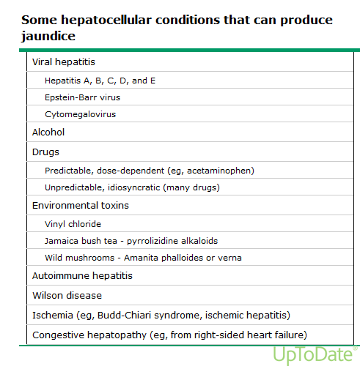

Slide 10
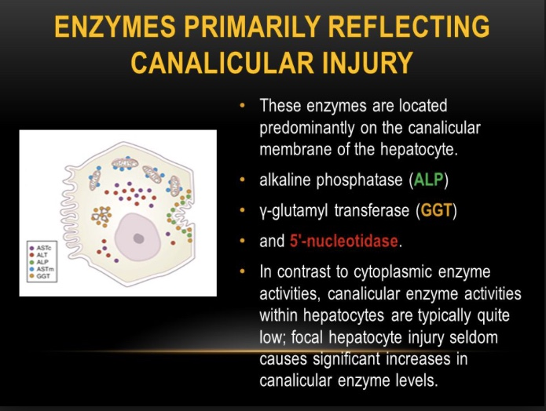

Slide 11
Cholestatic liver lesion
Marked elevation of AP (>4 times)
● Obstructive jaundice due to cancer
● Bile duct stones
● Sclerosing cholangitis (primary or secondary)
● Bile duct stricture
● Drug and toxins associated with cholestasis
● Primary biliary cholangitis
● Liver allograft rejection
● Infectious hepatobiliary diseases seen in patients with AIDS (eg, cytomegalovirus or microsporidiosis and tuberculosis with hepatic involvement)
● Infiltrative liver disease (eg, sarcoidosis, tuberculosis, metastatic malignancy, amyloidosis)
● Alcoholic hepatitis (rarely)
Moderate elevation of AP
viral hepatitis
chronic hepatitis
cirrhosis
infiltrative diseases of the liver
congestive heart failure
Hodgkin lymphoma
myeloid metaplasia
intra-abdominal infections

Slide 12
Differential diagnoses?
Further procedure?
Diagnostic workup?

Slide 13
Laboratory results on admission
E 5.08, Hb 153, MCV 88.4,
WBC 12.3, ne 20, ly 41, reactive ly 28, mo 10, plasma 1,
Plt 110
CRP 19.1
Glucose 5.4, urea 5.5, creatinine 112, Na 135, K 4.1, Cl 93
Bilirubin 195 (conj 108), AST 142, ALT 234, GGT 617, AP 663, LDH 627
PT 1.01, INR 0.98, fibrinogen 4.8
TP 77, alb 44 g/l (alb 57.1-alfa1 4.3-alfa2 8.4-beta 11.7-gamma 18.5%)

Slide 14
Abdominal ultrasound
Liver slightly enlarged
Splenomegaly, 21 cm
Gallblader and biliary tract normal

Slide 15
Laboratory results
EBV VCA IgM positive
EBV VCA IgG negative
EBV EA IgG negative
EBNA negative
CMV IgM positive
CMV IgG negative
EBV PCR 57 400 copies
CMV PCR negative
Anti HIV, anti HAV, anti HCV- negative
Anti HBs positive
lymph node aspiration: reactive hyperplasia
Diagnosis:
ACUTE EBV INFECTION

Slide 16
Therapy, disease course
parenteral rehydration, acetaminophen, ibuprofen
patient became febrile on the 3rd day of hospitalization
lymph nodes on the neck have enlarged, exudative tonsillopharyngitis developed
icterus and pruritus slowly regressed

Slide 17
Discharge
E 4.28, Hb 128, MCV 88.2,
WBC 8.4, ne 32, ly 43, reactive ly 13, mo 10, plasma 1, eo 1
Plt 153
Bilirubin 57, AST 45, ALT 110, GGT 343, AP 453, LDH 438
Dg: Acute cholestatic EBV infection

Slide 18
Infectious mononucleosis
EBV
CMV, HIV, toxoplasmosis, HHV6, HHV 7
transmission - primarily saliva
incubation 4-8 weeks
Classic IM: fever, pharyngitis, adenopathy, fatigue
- enlarged lymph nodes, exudative pharyngitis,hepatosplenomegaly
Laboratory findings
Lymphocytosis (an absolute count >4500/microL or a differential count >50 percent)
Reactive lymphocytosis (>10%)
elevated LDH and aminotransferases

Slide 19
Infectious mononucleosis
Diagnosis
Serologic testing (EBV VCA IgM, EBV VCA IgG, EBV EA D, EBNA)
Heterophile antibodies
EBV PCR
Treatment
Symptomatic
Corticosteroids (for complications)
(acyclovir)

Slide 20
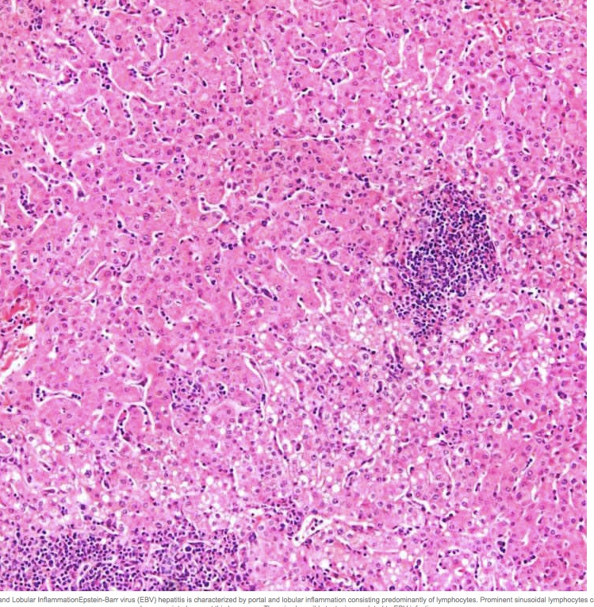

Slide 21
EBV induced cholestasis
Primarily an immune mediated phenomenon
Inflammation and swelling of bile ducts or direct damage to hepatic cells by autoantibody-mediated activation of free radicals
Treatment
- supportive measures
- corticosteroids and antivirals - limited data
- cholestyramine in cases of intractable pruritus

Slide 22
Epstein- Barr virus induced hepatitis: An important cause of cholestasis
24 patients
Median age 20 years, F 58%
most common signs: fever (72%), jaundice (67%) and splenomegaly (62%)
AST or ALT median 179 IU/ml
AP 749 IU/ml
Hepatology Research, 2005

